Slide 1
Flying UAS in Polar Regions: Operations and Regulations
Dr. Catherine F. Cahill
Director
Alaska Center for Unmanned Aircraft Systems Integration (ACUASI)

Slide 2
What is ACUASI?
ACUASI is the University of Alaska’s unmanned aircraft system (UAS) research program
ACUASI is a key partner in the Federal Aviation Administration’s Center of Excellence for UAS
ACUASI leads the Pan-Pacific UAS Test Range Complex, one of the six FAA UAS Test Sites

Slide 3
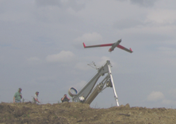
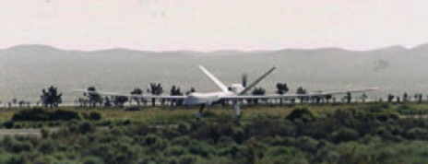
UAF’s Unmanned Aircraft History
2001 - Partnership with New Mexico State University
  Developed applications for the Technical
  Analysis & Applications Center (TAAC)
2003/2004 - Funded to work with USAF and USCG
  Maritime domain awareness
  Wildfires in the Interior of Alaska
2006 – Acquired first ScanEagle
2007 to present - Multiple missions for science, emergency response, humanitarian needs, and engineering and policy development
2012 - Alaska legislature funded $5M to grow program & pursue FAA Site
2013 – Selected as one of the six FAA test sites
2015 – Core member of FAA COE
    Lead on Maritime w/MSU
    Part of NASA’s UTM project
June 2007
First UAF Launch
Altair “Mariner” Alaska July 2004

Slide 4
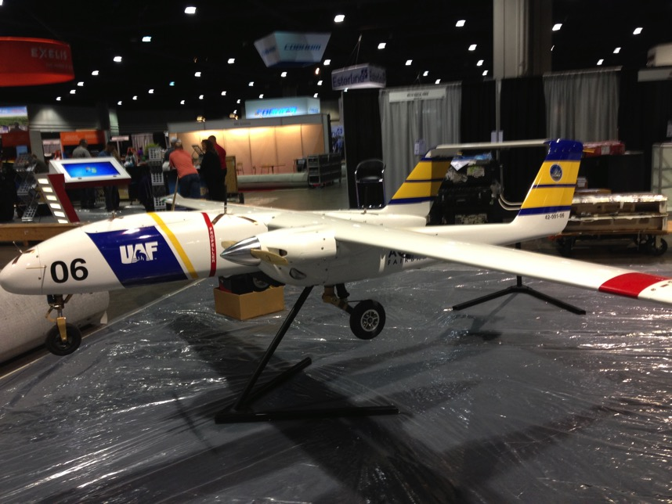
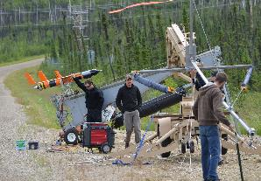
ACUASI’s UAS Fleet
ScanEagle, Nanook, SeaHunter, Responder, Scout, Ptarmigan, and others
Mostly catapult, hand, or vertical launch
Counter-rotating propellers, heated pitot tubes, fuel injected engines, or battery-powered
New auto pilot and control station for communication via satellite

Slide 5
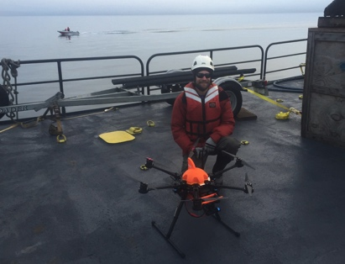
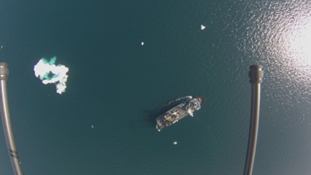
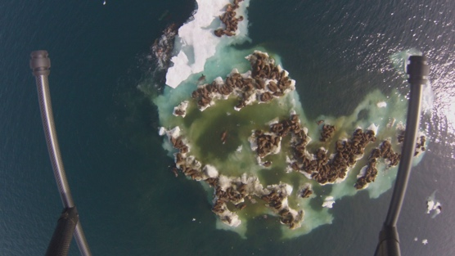
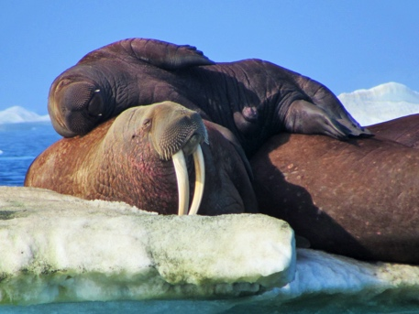
Walrus Studies
Ptarmigan, Ship Launch (2015)

Slide 6
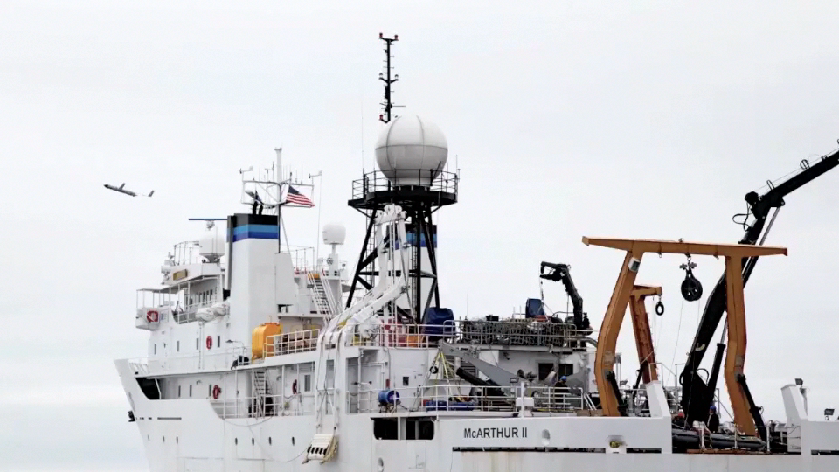
Ice Seal Monitoring

Slide 7
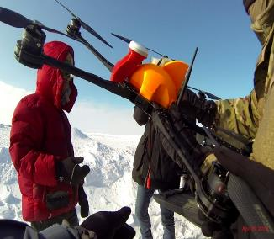
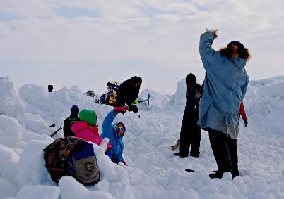
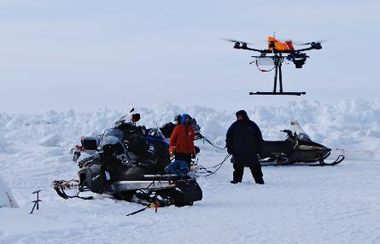
Sea Ice Survey – Barrow (April 2015)
“Ptarmigan” UAS was used to capture ice ridge data
Previously, technology providing reduced quality imagery had been relied on to break ice trails

Slide 8
Sea Ice Survey - Barrow
Data from the Sea Ice Survey was shared with the community. Mapped ice ridges define the area for ease of determining the best route for an ice trail for whale hunting.

Slide 9
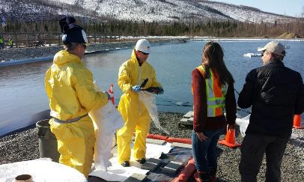
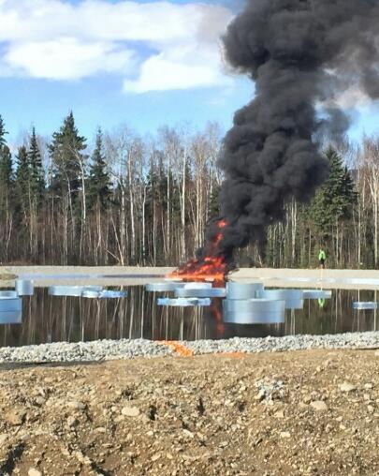
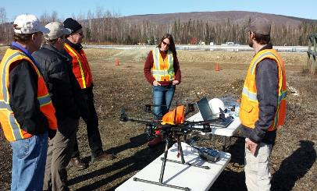
Herder Burner – Oil Spill Research
Poker Flat (April 2015)

Slide 10
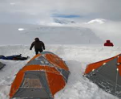
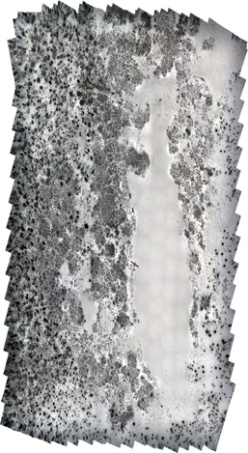
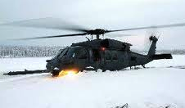
Bear Bite – Search and Rescue Exercise (SAREX)
Mass Casualty Exercise
“An aircraft crashed in the tundra roughly 20 miles outside Bethel Alaska many died with some survivors”
Deployed two unmanned aircraft systems with support team
Coordinated with manned aviation
on the scene
Mission:
  Map scene for event
  documentation
  Real-time SAR response
  Thermally identify casualties in
  deep snow
Cold weather operations: -35 F

Slide 11
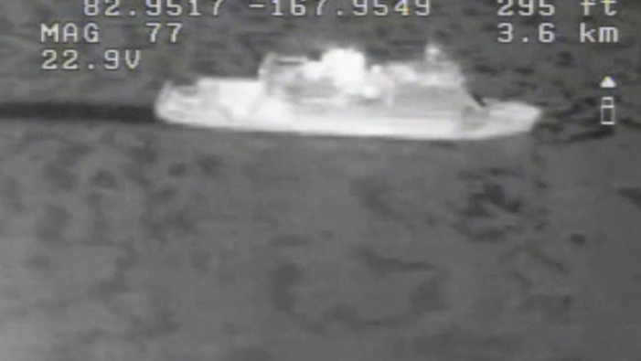
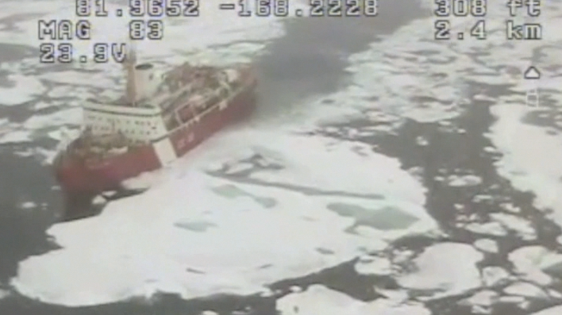
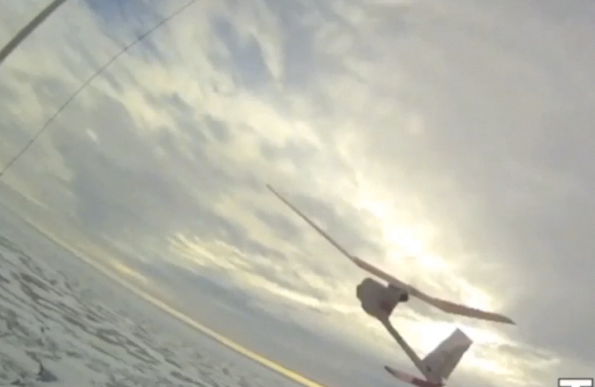
High Arctic Ship Piloting Experiments
Aboard the Canadian CCGS LOUIS S. ST. LAURENT
Phase I Research conducted by Capt Stephen Wackowski (USAF)
Phase II Ongoing with UAF graduate students with modified Raven systems acquisition

Slide 12
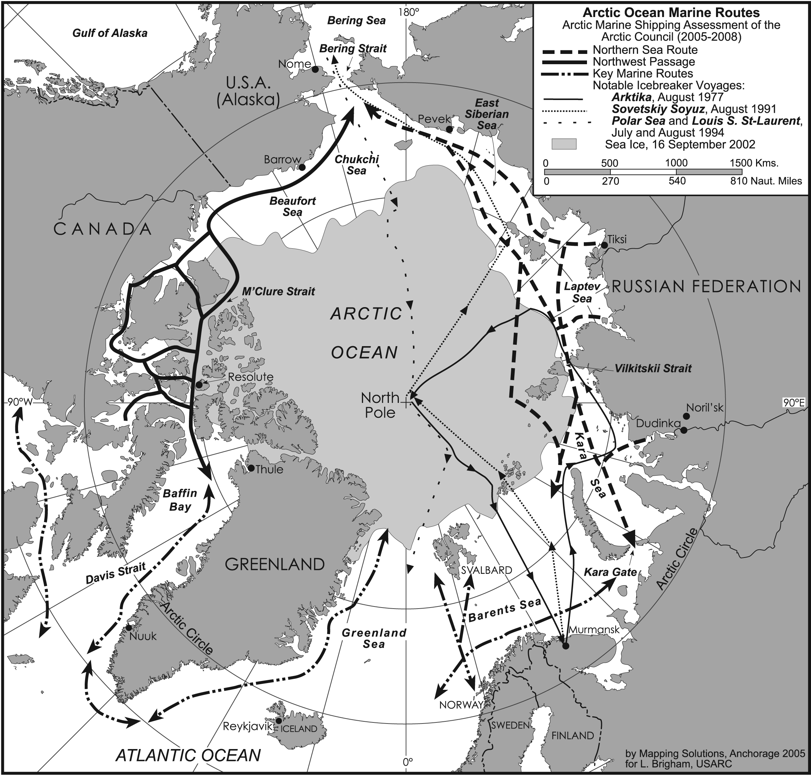
Todays Arctic
Marine Use
Zinc & Coal
Nickel & Copper
High Grade
Iron Ore??
Hard Minerals
Marine Tourism
Key Fisheries
Oil & Gas
Summer Sealift
Exploration/Science

Slide 13
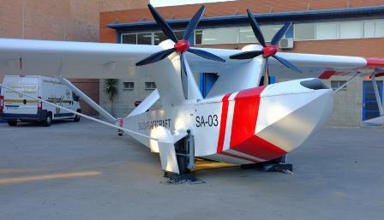
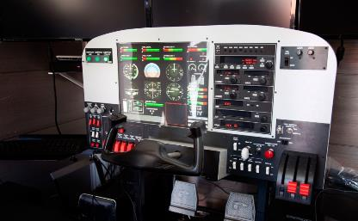
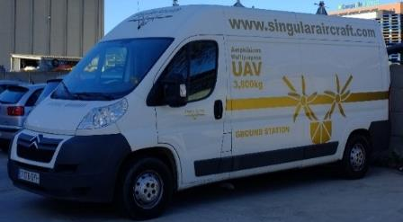
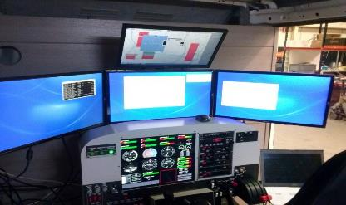
National and International Support
Testing of SA-03 in Iceland

Slide 14
Why National and International?
The Arctic contains the airspace of many different countries besides the U.S. as well as international airspace
Antarctica’s airspace varies by station/vessel country
The regulations for UAS usage vary country to country

Slide 15
Who’s Responsible for What?

Slide 17
High Seas (>12 NM from shore)

Slide 18
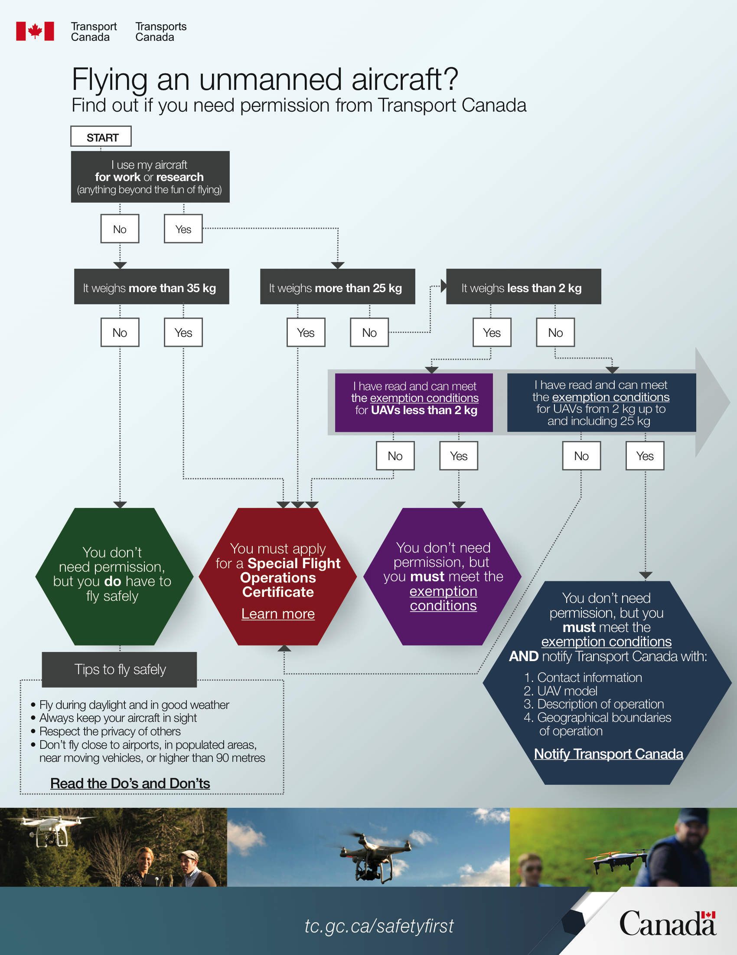

Slide 20
Integration of UAS into the NAS:
Challenges
FAA Concerns
  Detect & avoid
  UAS certification or equivalent
  Operator licensing
  Interaction with manned aviation & NAS protocols
Pathway to resolution of concerns
  Safety studies examining specific scenarios
  Developing standards at appropriate levels
  Advancing flight control & detection technology
  Lots of flights to provide data + analysis

Slide 21
Can I Fly in the U.S.?
Military
Public
Civil
Hobbyist

Slide 23
The Arctic Monitoring and Assessment Program’s UAS Handbook

Slide 24
AMAP SAR Communications Plan

Slide 25
Take Home Message - Permits

Slide 26
You Have Permission, Now What?
Now you face the challenges of flying in the Arctic or Antarctic
  Icing - Exposed Pilots
  Winds - Lack of hardware stores
  Cold - Poor communications
  Polar bears - Ships that don’t stop
  Significant manned aircraft activity
  And all the other issues polar researchers are familiar with

Slide 27
Icing Effects
Video clip

Slide 28
How Do You Successfully Fly?
Practice, practice, practice
Scientists would like to take a commercial off the shelf (COTS) system and fly it in the polar regions, with no experience operating it under those conditions
This will lead to accidents

Slide 29
Polar Issues
Battery life is significantly degraded
Aviation gas pollution
Plastics break
Wood glue (need I say more?)
Navigation is difficult (GPS is a problem)
Vessels may jam UAS frequencies
Crashes may occur in sensitive areas
  Environmental or historical damage
Not always possible to get the UAS back
Expensive logistics
Etc.

Slide 30
ACUASI’s Polar Role
ACUASI, in conjunction with the other experts at the University of Alaska Fairbanks, is playing a key role in applying UAS technology to polar, especially arctic, research
The University’s expertise is being applied to protect the environment of the Arctic and Antarctic as activity increases in the regions
The University’s relationships with communities, the military, industry, and all levels of government provide a platform for collaboration

Slide 31
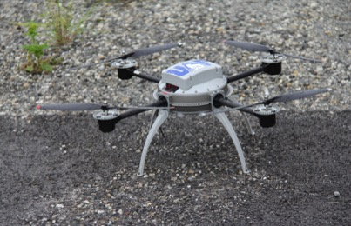
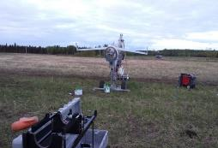
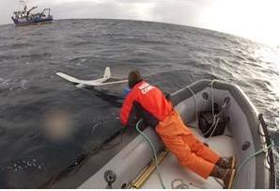
Polar UAS Summary
  UAS ideal for dirty, dull, and dangerous operations
  Systems need to be hardened for extreme cold and icing conditions
  Communication between practitioners will be essential for determining best practices
  Sharing logistical costs can make deploying UAS at the poles more affordable

Slide 32
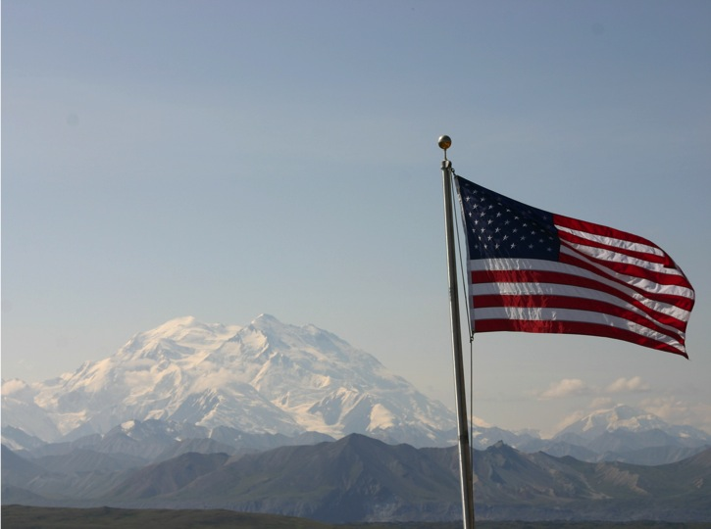
Thank you
Questions?

