Slide 1
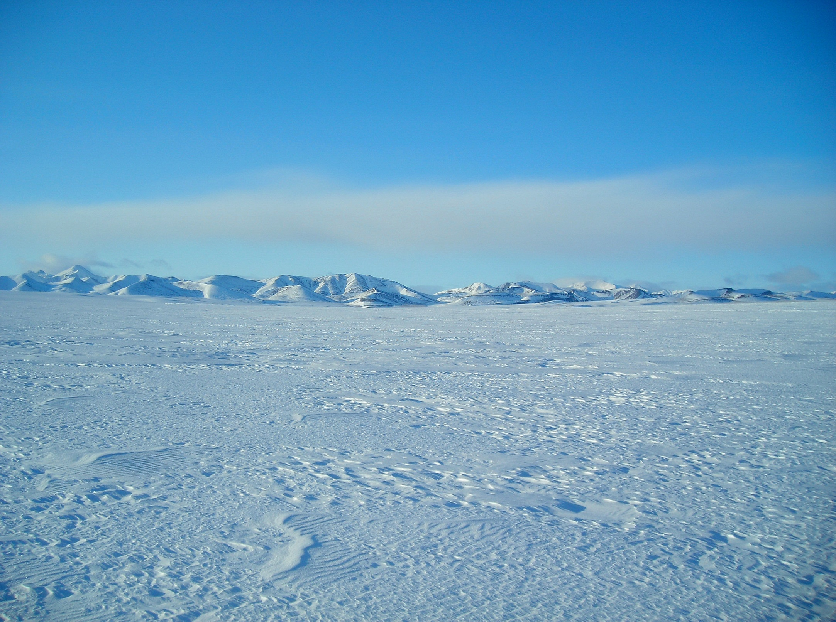
COTS to Custom
(and Custom to COTS)
Using Commercial Off-The-Shelf Products to Create Cost Effective Polar-Capable Solutions
2016 Polar Technology Conference
Tracy Dahl
Polar Field Services

Slide 2
Why COTS?
A pre-engineered and tested solution
Potentially lower cost
Potentially more reliable
Warranty – maybe….
Replicable simply by purchasing more units
Documentation is already done
Why Not COTS?
Few complete solutions available for our niche market
Not necessarily more reliable or warrantable
You don’t always know exactly what you are getting

Slide 3
Definitely Not COTS!

Slide 4
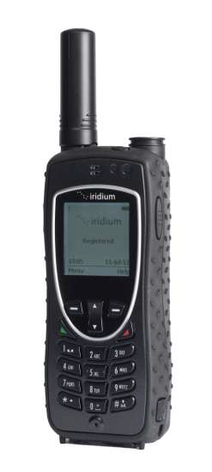
There are some good, complete COTS solutions available for our niche market.
APRS WT 14
Iridium 9575 Extreme Satphone

Slide 5
An Appropriate Middle Ground?
Developing cost effective custom solutions for specific project requirements by integrating quality COTS components into the design.
The “Solar Chalet”, Welker EAGER project, near Toolik Field Station, summer 2013.

Slide 6
Where Do These COTS Components Come From?
Renewable Energy Industry
(Outback, Morningstar, Genasun, Magnum, etc.)
Marine and offshore boating industry
(Blue Sea, Marinco, etc.)
Aerospace Industry
(Murata Power Solutions, etc.)
DigiKey, Grainger, Home Depot – Basically from wherever you can find the things that work at a reasonable cost.

Slide 7
100% COTS Components
Aluminum job box
Deep cycle batteries selected to fit
Sealed Outback FX mobile inverter
Three Outback charge controllers
Three Iota battery chargers
Bender GFCI
Standard electrical components
Specialized electrical supplies:
- Polar Wire “Arctic Ultra-Flex”
- Armored mining cable “MC”
Construction supplies from Home Depot:
- Plywood
- Rigid insulation
- Polycarbonate
- ABS plumbing pipe
Honda generator

Slide 8
Instrument Site: 48VDC > 12VDC Power
Murata @ 90%
Analytic Systems @ 80%

Slide 9
Comparative Hardware Analysis
Hardware | Temperature Range | Ruggedness | Price
Analytic Systems | -20C (-40 available) | Nice Enclosure | $354
Murata Power Solutions | -40 C (-55 storage) | Open Frame (backplane avail) | $38
Sometimes Other Factors Can Influence Decisions
Availability
Both use conformal coated circuit boards
Housed in NEMA 4X enclosure
Temperature range on the Murata slightly better
Cost: Analytic Systems price much higher – mostly paying for enclosure
Field experience – Don’t always believe the spec sheet! Exeltech inverter example

Slide 10
Comparative Energy Analysis
At a 100W nominal, year-round load
Hardware | Actual Load | Daily Energy | Annual Energy
Analytic Systems | 120 Watts | 2.88 kWh | 1.05 MWh
Murata Power Solutions | 110 Watts | 2.64 kWh | 963.60 kWh
Difference | 10 Watts | 240 Wh | 87.60 kWh
Little differences add up to major differences over time! Perhaps even more important, consider that the 90 days in the middle of winter when there is little to no solar input to the efficiency difference amounts to almost 26 kWh of energy wasted.
Do the research
Make the right choice
Integrate it into the system properly
Keep notes on what works and what doesn’t and share it

Slide 11
Standard COTS Components Combined for Cost Effective Custom Solution
Kangerlussuaq, Greenland 2kVA Power Conversion Devices
230V @ 60Hz to 115V @ 60Hz
The only non-standard (US) component is the Danish plug
Note crating for overseas shipment

Slide 12
10kVA 380VAC/3-ph > 120/240VAC

Slide 13
Custom Solution – COTS Components
Summer-Only, >100W Continuous, Highly Mobile, Fast Set-Up

Slide 14
Reoccurring Themes
COTS Advantech Low Power Computer
Marinco Trolling Motor Plug/Socket

Slide 15
ITEX - Barrow BEO
Standardized Designs and Components
Grizzly Cooler Enclosures for year-round
Simple, robust frames
Room to expand if loads increase
Insulated Cooler Enclosure
Armored Liquid-Tight MC Cable
Remote AC/DC Power Drop

Slide 16
Custom Evolving Towards COTS
Space for Communications
Hardware
All systems include tools & manual
Extra Room for Science or Personal Gear at the Field Site
Battery box also insulated. Room for expansion of energy storage if required.

Slide 17
Cooler Enclosures 100% Snow/Liquid Tight
Low-Power SBC
Blue Sea ATC Fuse Block
Morningstar Inverter

Slide 18
UNAVCO’s Spencer Niebuhr on Mt Erebus
Specific engineered solution developed with an NSF technology grant
Available to researchers
Is this now a COTS system?

Slide 19
COTS Twist 1
DC Rated NEMA 1, 3-Pole Disconnect Housed in a NEMA 4X Enclosure
Achieves the same level of environmental protection at a fraction of the cost.

Slide 20
Conclusions:
Using appropriate high quality COTS components can create custom, cost effective solutions
Process trends towards standardized designs and component selection
Take the time to document for greater efficiency when replicating the design
Provide good O&M manuals with schematics and tools
Ultimately, this process results in something very similar to a comprehensive COTS model

Slide 21
Where To From Here?
Identify COTS systems, hardware, components that can make the grade – and those that cannot.
We need to learn from each others successes and failures.
Our little community needs to communicate more than once a year.
Develop an ever evolving list of “the stuff that works” and where to get it?
Open discussion

