Slide 1
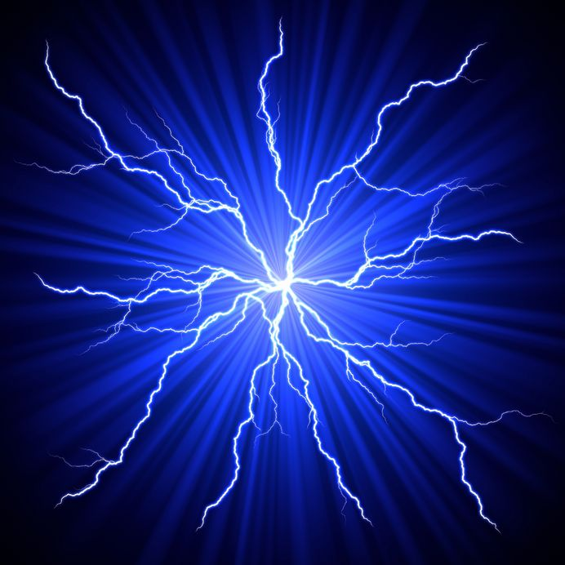
Dealing With Static Discharge In Polar Environments
Dealing With Static Discharge In Polar Environments
2016 Polar Technology Conference Workshop Topic
Facilitated by Tracy Dahl, Polar Field Services

Slide 2
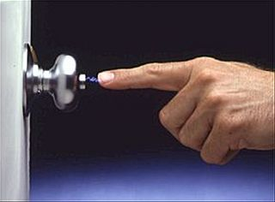
What’s the Problem?
Dry and/or frozen environment with poor or no earth ground
Wind driven snow develops static potential
If not addressed, can cause anything from mild annoyance to expensive and potentially project threatening equipment damage.

Slide 3
What Is It?
Static electricity is the buildup of electrical charges on the surface of non-conducting materials.
Static can be thousands or even tens of thousands of Volts, but almost no current.
Static typically forms when two materials come into contact, and some of the charges redistribute by moving from one material to the other. This leaves a net positive charge on one material and an equal negative charge on the other, both of which will remain if the two materials separate. If the net charges grow faster than a material can dissipate them, an electrostatic charge builds up.
The excess charge can suddenly neutralize by a flow of charges to the surroundings, known as an electrostatic discharge or static spark. By super-heating the surrounding air and causing it to rapidly expand, the discharge is both visible and audible.

Slide 4
Controlling Static Discharge
Pick a more humid environment to work in
Reduce potential between sources by tying together with a really good equipment ground. In some locations it makes sense to run a grounding bus on the walls.
Transient voltage surge suppression
Anti-static wrist bands or other means to reduce potential
Conductive anti-static floor and bench mats
Electrically isolate with independent power supplies, etc.
Employ static dissipators

Slide 5
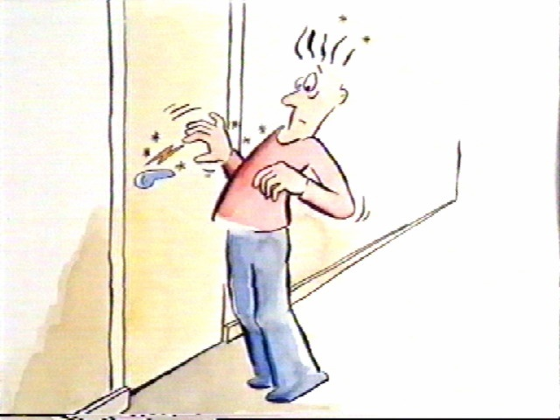
Static Dissipator Type 1

Slide 6
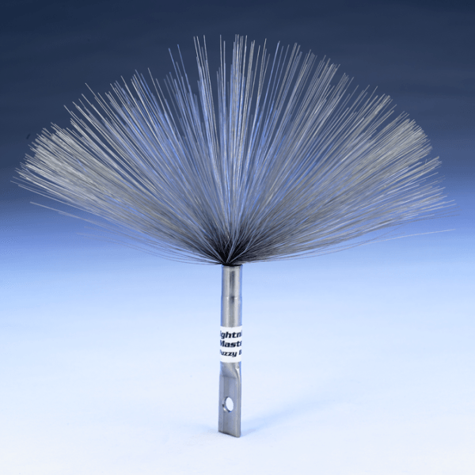
Static Dissipator
Type 2

Slide 7
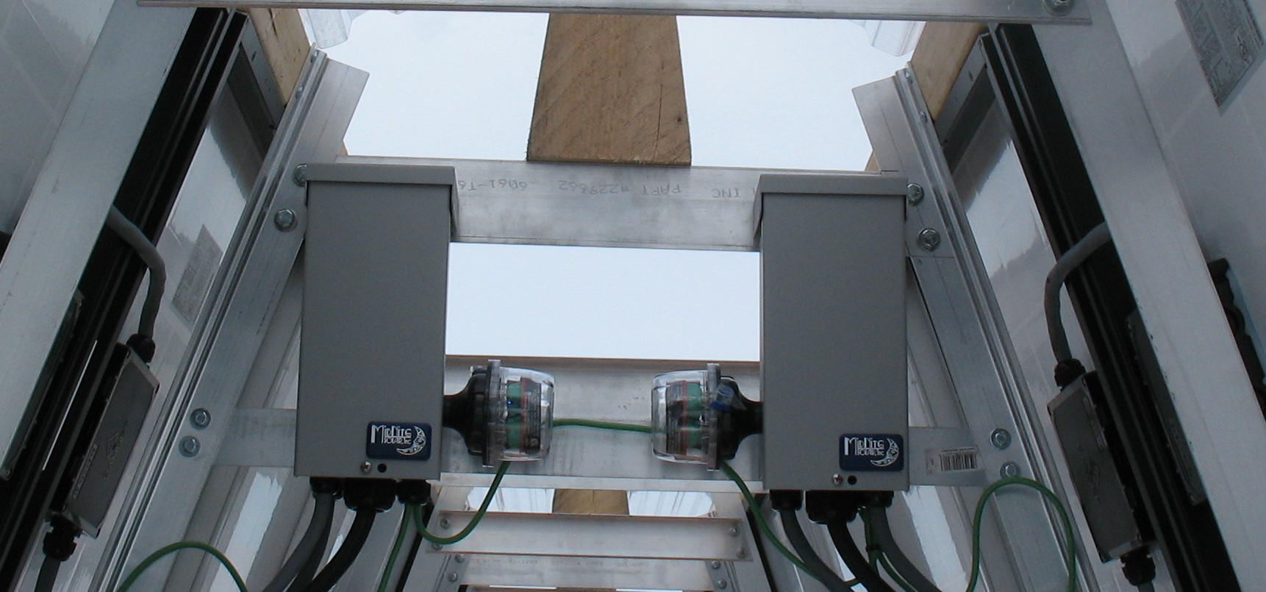
Surge Suppression
Forget the old Delta surge arrestors
Newer, far more sensitive devices are available that use metal oxide varistors (MOV’s).

Slide 8
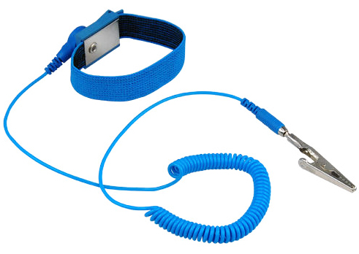
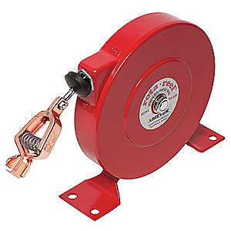

Slide 9
Sometimes more really is better. Substrate with poor conductivity requires extensive measures.

Slide 10
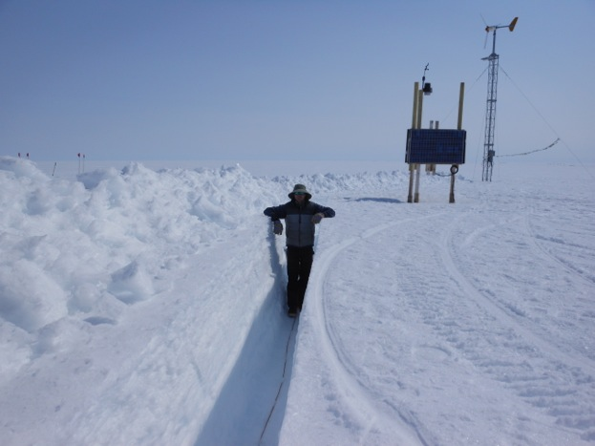
Grounding Trunk Line @ Camp Raven
Courtesy of Drew and Silver Williams

Slide 11
Camp Raven Example
Shotgun Approach: Grounding trunk line providing a common reference, static dissipator, anti-static mats, separate UPS for computer, surge supressors.
Issue was resolved but we don’t know for sure which of the five technologies employed was the true “cure”.

Slide 12
Open Discussion
How bad has this problem been for others?
What approaches have been implemented?
Resources?

