Slide 1



Advances in Remote Seismic Station Technology
Polar Technology Conference 2016
Notes:
Hi my name is Jason Hebert. I am the Polar services manager with IRIS PASSCAL. Today I am going to talk about advances in remote seismic station technology.

Slide 2
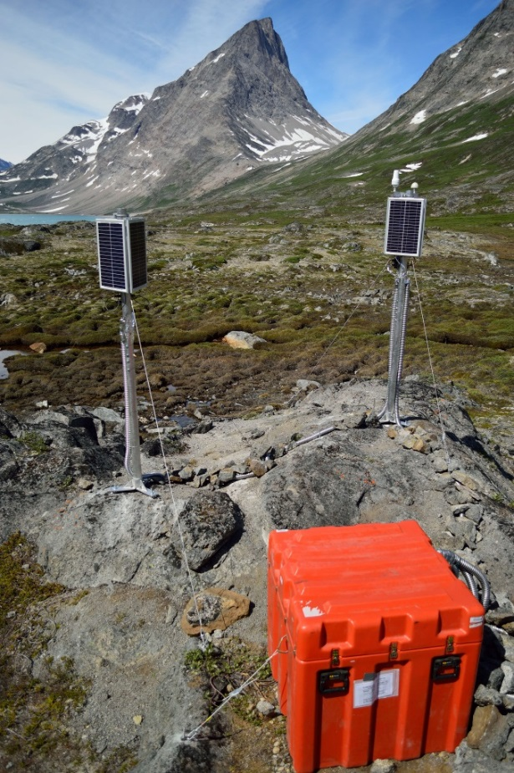
Overview
  PASSCAL Program
    Polar Program
  Telemetry Updates
    Iridium Pilot Testing
    RUTUS Tunnel Software
    XI-202 Multi Firmware
  Power Updates
    Aircells and DC-DC convertor
    WT10 Wind Generator
  Portability Updates
    RIS/DRIS Deployments
    GEOICE MRI Project
Notes:
I realized last night while going through these slides that I have way more than I can fit into 20 minutes and that each of these sections could probably have their own presentation, but I will try and move quickly. I am going to start by giving a brief overview of who we are and what we do, followed by updates in what I think are pretty common things among all of us doing remote data collection in polar regions; data telemetry, power, and portability or logistical optimization.

Slide 3
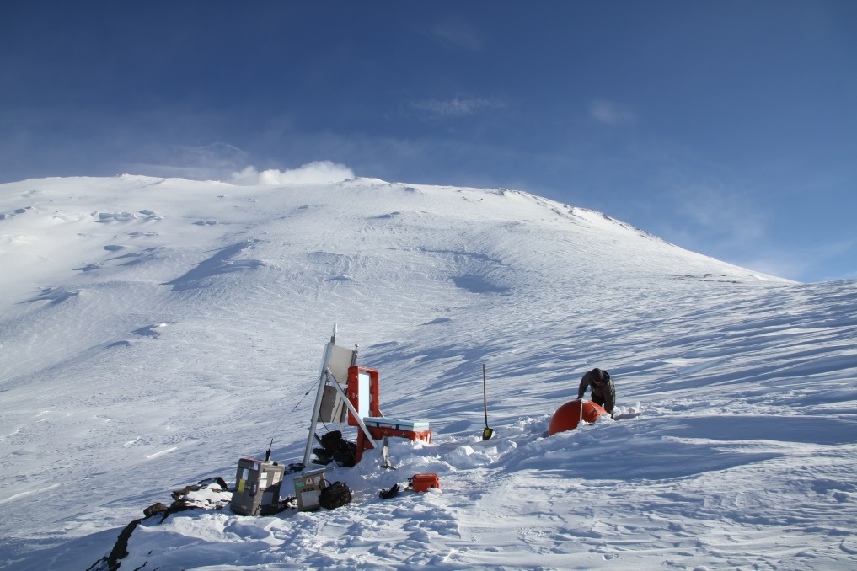

Program for Array Seismic Studies of the Continental Lithosphere
PASSCAL Instrument Center (PIC)
Facility provides instrumentation to NSF, DOE or otherwise funded seismological experiments around the world
Services include, but are not limited to:
  Seismic instrumentation
  Equipment maintenance
  Software
  Data archiving
  Training
  Logistics and shipping
  Engineering support
  Field Support
Notes:
PASSCAL stands for ‘Program for Array Siesmic Studies of the Continental Lithosphere”. The PASSCAL Instrument Center (PIC) is located in Socorro New Mexico on the campus of the New Mexico Institute of Mining and Technology. We provide seismological instrumentation and support for seismic experiments operating around the world.

Slide 4
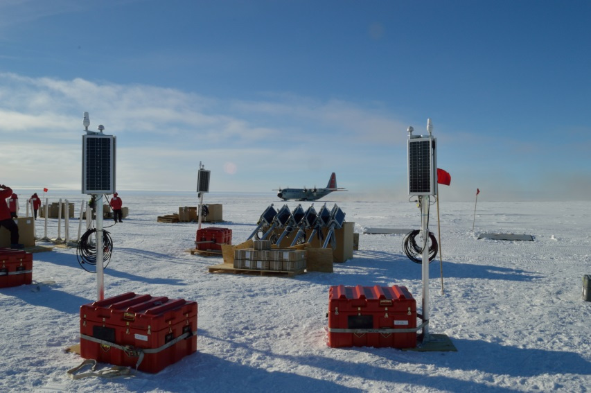
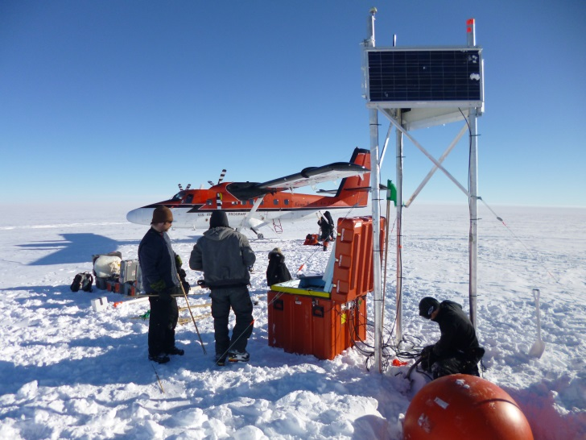
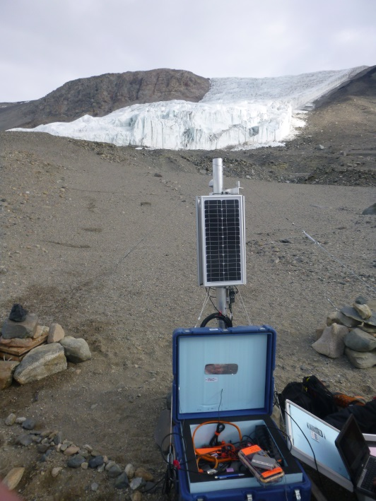
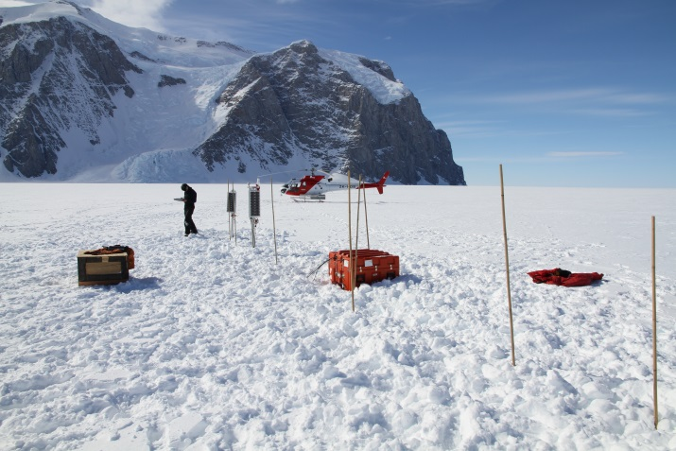
POLAR Group
Formed to address the unique engineering challenges associated with operation in remote polar regions
Currently 3 full time staff, as well as additional employees partially funded by Polar budget
Spend ~12-16 weeks in the field each
Notes:
The Polar Group was formed to address the unique engineering and logistical challenges associated with operating in remote regions of the Arctic and Antarctic. We currently have 3 full time staff as well as additional personnel paid partially out of the Polar budget. In addition to design, engineering and logistical support we spend approximately 12-16 weeks a year or more each providing field support.

Slide 5
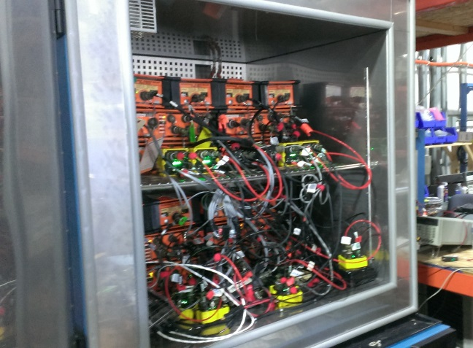
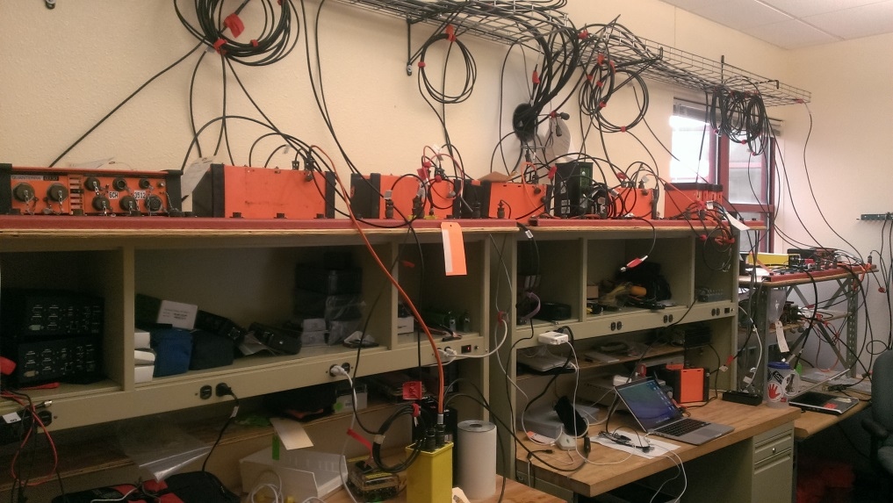
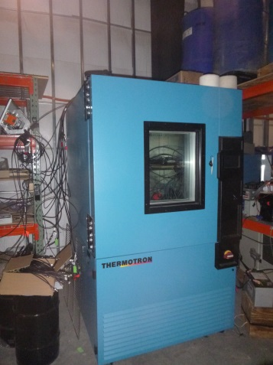
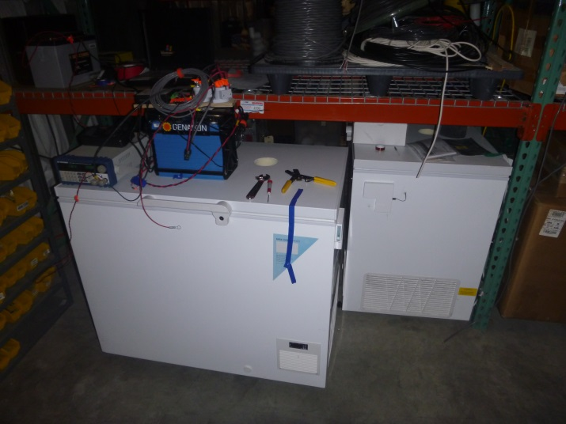
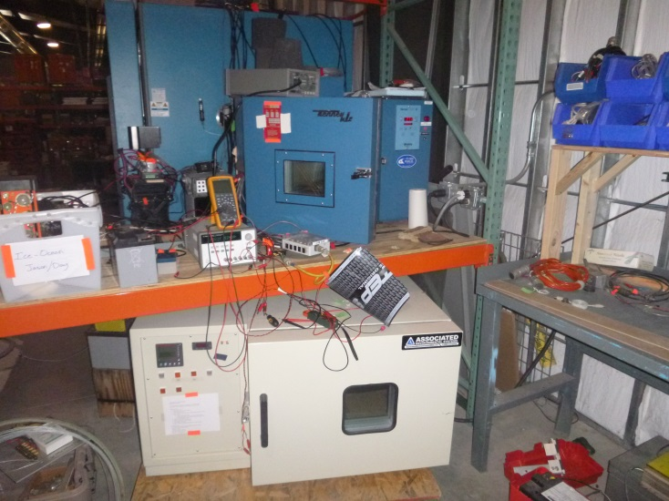
POLAR Group
Notes:
Our facilities for Polar specific development include:
Fabrication area
Warehouse storage
Warm testing lab
4 Fully programmable (2 large 2 small) +
2 Large cold chambers (32 ft³ & 27 ft³)
2 Smaller cold chambers (~2 ft³, ~4 ft³)
2 laboratory chest freezers (8.1 ft³ & 10.6 ft³)
Long term cold testing
Polar Lab
Iridium & GPS antennas
Solar
FW and basic bench testing – 10qty
R&D, Prototyping
2 chest “setpoint” freezers for long term testing

Slide 6
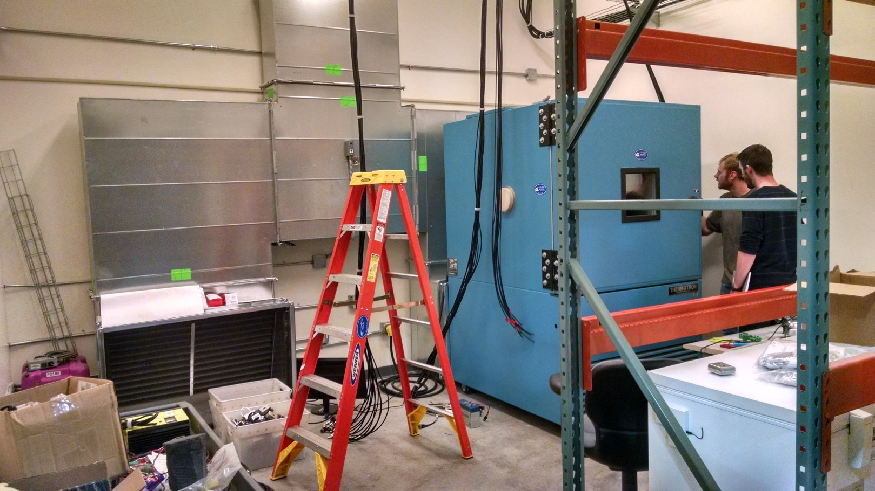
POLAR Group
Dedicated cold Testing Room:
  Warehouse climate control insufficient for summer freezer operation
  Enclosed room within warehouse with refrigerated air and heat exhaust vents
Notes:
We recently had a room enclosed within the warehouse to house our cold testing equipment. The warehouse evaporative cooler climate control was not sufficient for operation of the freezers during the heat of Socorro summer, which is when we do the bulk of our testing. The room has an independent ac system, and space for all of our freezers. The two large freezers have additional air exhaust venting for keeping the compressors cool. It is nearly move-in ready. You can see the antenna cable drops for Iridium telemetry and gps timing here, and on the near wall is shelving for our smaller freezers with the chest freezers below.

Slide 7
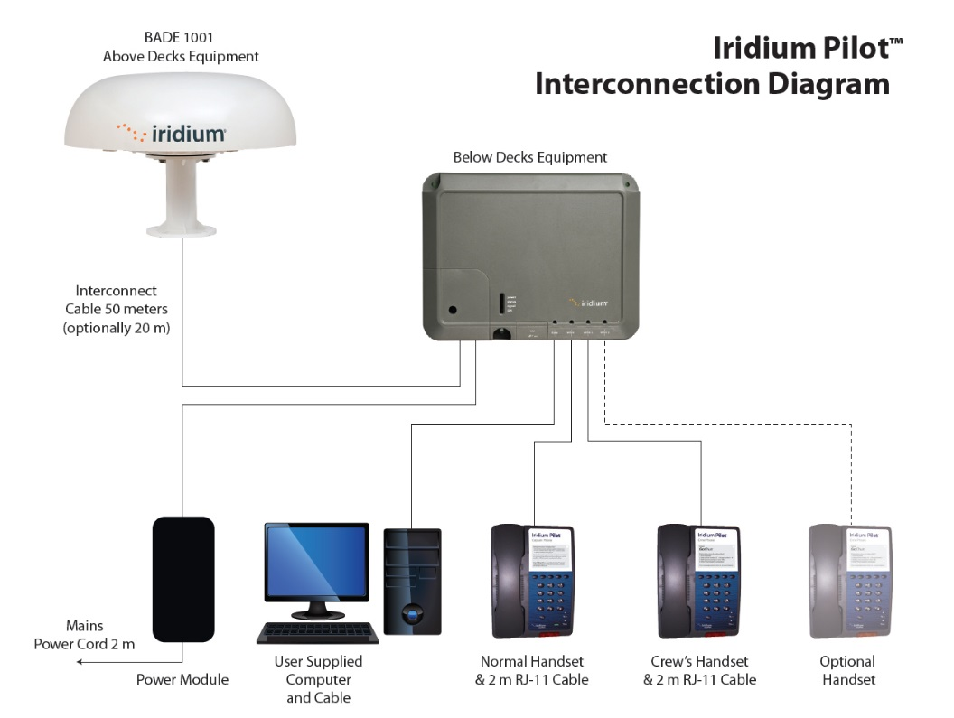
Iriduim Pilot
Funding was obtained from the Greenland Ice Sheet Monitoring Network (GLISN) for the testing of an Iridium Pilot system in interest of expanding “real-time” telemetry capability utilizing Iridium OpenPort service.
  Designed as an expanded Iridium communication device for Marine applications
  Up to 15KB/sec transmission (3rd party tested), compared with ~250 Bytes/sec running to RUDICS on current hardware (XI-100)
Notes:
We obtained funding this past year from the Greenland Ice Sheet Monitoring Network to obtain an Iridium Pilot for testing in the interest of expanding our “real-time” telemetry capability. The pilot utilizes Iridium OpenPort service, which allows for data transmission rates of up to 15KB/s, as compared to ~250 Bytes/sec running Rudics on our current hardware.

Slide 8
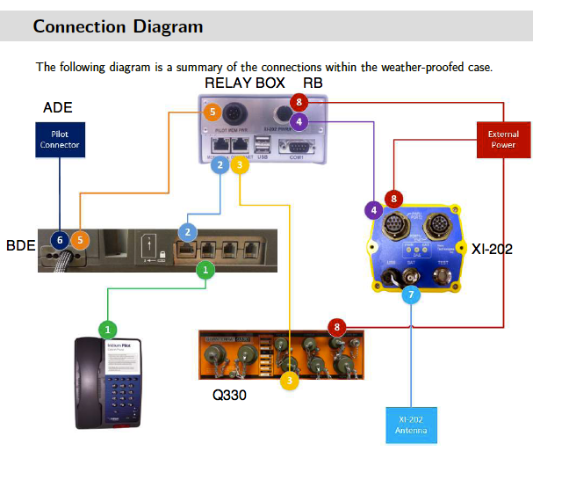
Iriduim Pilot
Xeos Integration
XI-202 acts as controller for relay box, powering system at set time intervals
Relay box controls power to Iridium “Below Deck Unit” (BDU)
Notes:
Part of that funding included a development effort by Xeos Technologies to integrate the Pilot with our systems, allowing us to control the Pilot I/O remotely. The system utilizes an XI-202 SBD modem connected to a relay controller, which controllers the power to the Pilot “Below Deck Unit” or BDE.

Slide 9
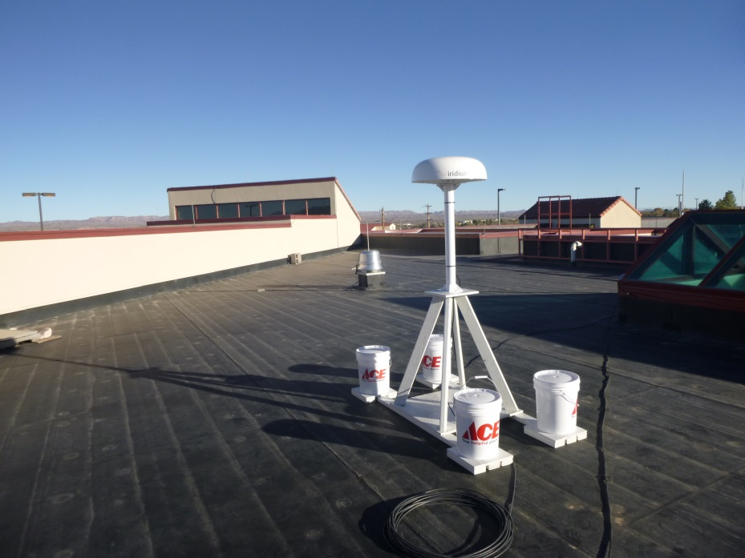
Iriduim Pilot
Initial Testing
Initial testing of an Iridium Pilot unit has been conducted at the PIC over a period of 5 days. A Q330 system was run with a broadband seismometer attached, sampling at 40Hz and 1 Hz on 3 channels, in addition to 12 SOH channels sampling at .1 Hz. The Pilot timers were set for 4 25 minute sessions per day. Power and data throughput data was collected over the 5 day period.
Initial Results:
Power:
  25.4W Average recorded power when Pilot is on
  1.8W average over 24hr period
Data Rates:
  11.7 MB/day moved (Tx-Rx, from Pilot web interface)
  2.3 KB/sec average throughput*
*Published rates, confirmed by testing should be closer to 15KB/s. System needs optimization
Notes:
Initial testing of the pilot unit has been conducted at the PIC over a period of 5 days. A Q330 digitizer was run with a broadband seismometer attached, sampling at 40 and 1 Hz, in addition to .1 Hz SOH Channels. The Pilot timers on the XI-202 were set to 4 25 minute sessions per day. Power and data throughput data was collected over the five day period and it was found to consume an average of 25.4W when powered, or approximately 1.8W averaged over a 24Hr period (about 100% more than standard SOH only telemetered sites). We moved approximately 11.7MB/day for an average of 2.3KB/sec moved during up time. This is substantially less than published rates, and I’ll get to the why of that a little bit.

Slide 10
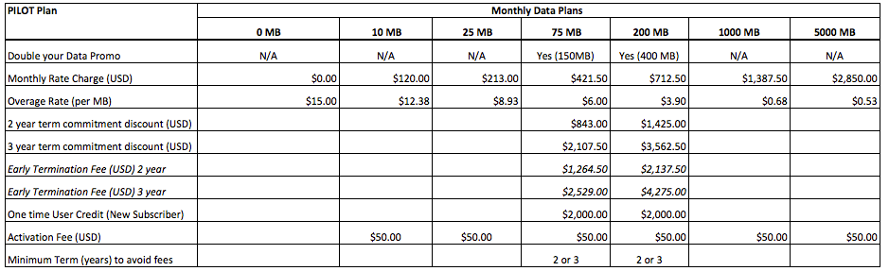
Iriduim Pilot
Cost/Feasibilty: Estimated annual costs based on average Antarctic data production of 7.8Mbyte/mo. at 40 and 1Hz 3ch seismic data + SOH (~237Mbyte/mo).
  Unit Cost: $5000 (does this include Xeos hardware?)
  Cost/year 1 unit: $8550 (based on published rates)
  Nominal additional cost of XI-202 commercial plan (~$200/yr)
  Pooling options available
Notes:
The initial hardware cost is ~$5000 including the additional hardware from Xeos. Based on published rates from Xeos Technologies, at the average data production rate of ~7.8Mbyte/day seen in Antarctica sampling at 40 and 1 Hz, we can expect to run a Pilot station for approximately $8500 per year. There are also pooling options available which we haven’t fully explored yet where we could share data across units, potentially lowering the overall cost per unit.

Slide 11
Iriduim Pilot
Initial Results: Results of initial testing show that the Pilot could be an effective and affordable means of moving “real time” seismic data in some instances. Further testing and optimization is warranted.
Issues/Optimization:
  Antenna unit shuts off at -40C. This may be a firmware setting. More time is needed to source the cause.*
  The Q330 digitizer-server is the primary throughput restriction , being designed for minimum latency NOT maximum throughput.
      This could be resolved by moving files off the data archiving unit , or pulling direct from Baler 44. Initial tests done by Xeos show peak throughputs of up to 15Kbyte/sec, which corresponds to the vendors claim for max throughput.
      Make system “smarter”, ie have Q330 control Pilot I/O, have relay power on Baler44 rather than powering continuously
Continued Testing
  Continued tuning of Q330 telemetry and Antelope server settings
  Environmental chamber cold testing
  Test unit will be installed at GLISN network site near DY2 site on the South Greenland Ice sheet this summer and run over winter
*Note: Antenna unit is temp rated for -30 to +70C
Receiver module temp rated for 0 to 50C
Notes:
Initial results show that the Pilot could be an effective and affordable (relative) means of moving real time seismic data in some instances. Further optimization needs to be done to shore out inefficiencies, in particular the movement of data off the Q330. The Q330 was designed for minimum latency, not max throughput. Some potential solutions include moving the data archiving off secondary archiving unit, or pulling from the storage media rather than the Q330s buffer. This would require some additional I/O smarts however to keep the power in an acceptable range.
Continued testing will include bench testing and further tuning of the Q330 and Antelope database telemetry settings, cold testing in our environmental chambers, and installation of the unit for a year round test near the DY2 site on the South Greenland Ice sheet, collocated with a current GLISN station.

Slide 12
RUdics TUnnel Software (RUTUS)
Web interface developed by Xeos Technologies Inc. to improve and ease the configuration, control and data throughput of Xeos modems. The old tunnel was developed as a prototype. It is slow to use, buggy, and offers limited diagnostics.
Timeline:
May 2014 proposals
August 2014 we had some funding.
January 2015 RUTUS continuous testing begins at PIC with 2-7 modems.
June 2015 Tunnel core stabilizes
October 2015 Most GUI problems worked out
October to present Continuous Testing continues with 3-4 modems
Notes:
Rudics tunnel software or RUTUS is a development effort we have undergone with Xeos Technologies to develop an improved tunnel software for Rudics telemetry over the past year and a half to address some of the limitations of the current tunnel software.

Slide 13
RUdics TUnnel Software (RUTUS)
Improvements over old tunnel:
Eliminated socket hang issue
Automatic modem configuration server for both xi100 and xi202 (continuously checks modem config states and adjusts if state does not agree with that setup in RUTUS). Note xi202 capability still under development.
Tunnel configuration templates reduce configuration setup time and errors
Allows IP based SBD reception of Mobile Originated (MO) messages (eliminates CPU hogging scanning of very large email accounts). Still allows email based SBD deliveries.
Built in warnings to prevent duplicate port-usage configurations.
Notes:
Eliminated socket hang issues. Allowes for automatic configuration of both XI 100 and XI 202 units, as well as Pilot configurability. Tunnel configuration templates, reducing setup time and errors. Allows for IP based SBD reception of Mobile Originated messages (eliminates CPU hogging scanning large email accounts). Built in warnings to prevent duplicate port-usage configurations.

Slide 14
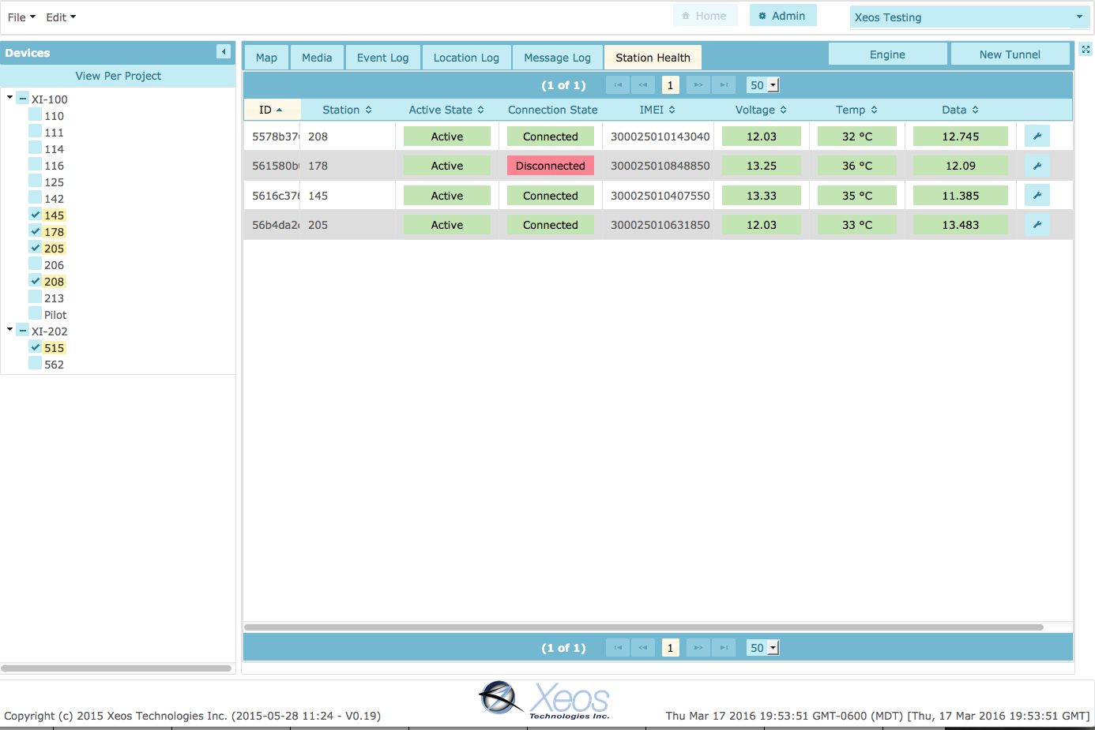
RUdics TUnnel Software (RUTUS)
Notes:
This is a picture of one of the pages, showing units organized on the left and configuration and data pages on the right.

Slide 15
RUdics TUnnel Software (RUTUS)
Further Testing:
  Deploying new firmware on GLISN network this summer
  Continued in-house bench testing at PIC
Future developments:
  Integration of database into RUTUS
  Graphical interfaces to display RUDICS data flow, and SBD messaging frequency and types.
  Smart RUTUS-side management of rudics on off states of the modem to minimize power consumption.
  Capability to configure groups of modems via a single submit.
  Template based en-masse tunnel configurations
Notes:
Testing will continue at the PIC as well as in the field, with an updated FW allowing for GLISN network XI-100s to be moved to the new tunnel. Further developments we hope to pursue are to include integration of a database into RUTUS and which graphic display of network data, smart RUTUS-side management of RUDICS I/O states, group configurability.

Slide 16
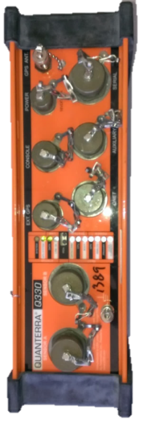
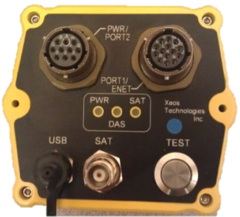
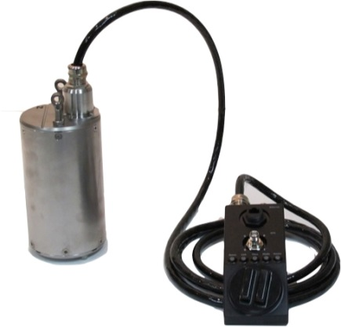
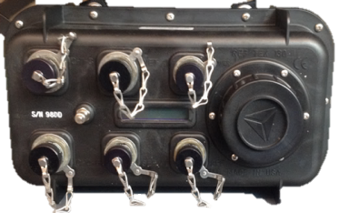
XI 202 Multi Firmware
      XI-202 Multi Firmware
      We are currently working with Xeos Technologies to develop firmware for the XI-202 (SBD only) capable of communicating with all data loggers currently used at the PIC for broadband seismology, expanding our capability to include Reftek and Nanometrics data loggers in addition to the Quanterra Q330, which was previously the only supported unit. The beta version is currently in testing and the software group is working on writing the parsers needed to translate the messages so they can be displayed on our webpage.
Quanterra Q330
Xeos Technologies XI-202
RefTek RT-130
Nanometrics Meridian/Centaur
Notes:
We are currently working with Xeos to develop firmware for the XI-202 SBD only unit capable of communicating with all data loggers currently used at the PIC for broadbabnd seismology, expanding our capability from just the Quanterra Q330 to the RefTek RT130 and the Nanometrics Meridian and Centaur data loggers. We currently have a beta version which is in testing.

Slide 17
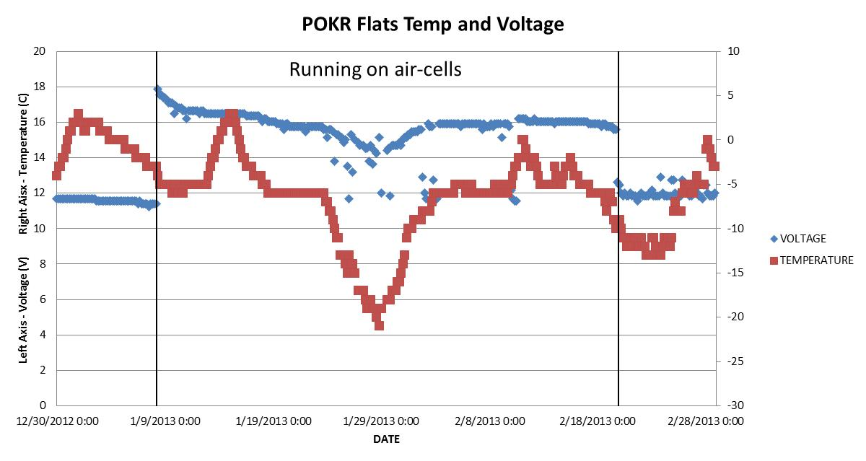
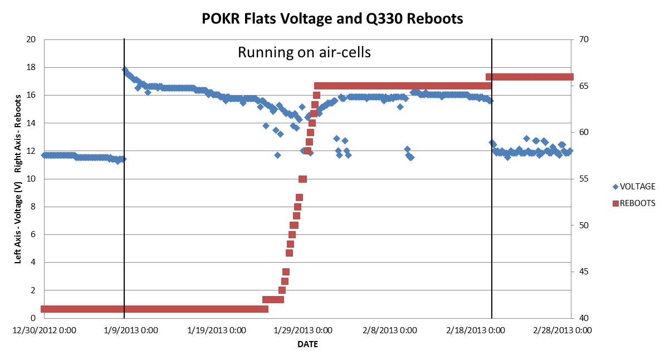
Due to increasing demand/interest in Air Alkaline Batteries, PASSCAL has been testing cells in a variety of conditions to verify characteristics.
Air Alkaline Batteries
Pros
High energy density
Inexpensive
Non-hazardous (easy to ship)
Cons
High Impedance (can’t source large amounts of current)
Poor cold weather performance
Require air supply
Notes:
Moving on to power, we have had a lot of interest shown in Air Alkaline batteries over the past couple of years due to their high energy density and relatively low cost. We began testing them at Poker Flats in Alaska in 2013 and quickly realized that there poor performance at low temperature made them a questionable choice for cold environments. You can see here that as the temperature declines the batteries lose their ability to source the pulse currents associated with media writes and telemetry turn ons. The upper graph shows an overlay of voltage and temperature, while the loser graph shows the reboots associated with these voltage drops, resulting in data loss.

Slide 18
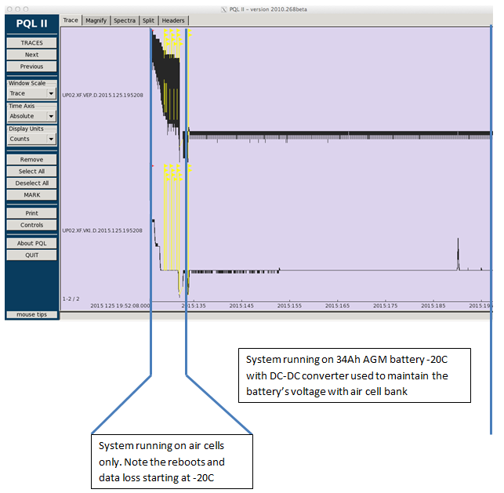
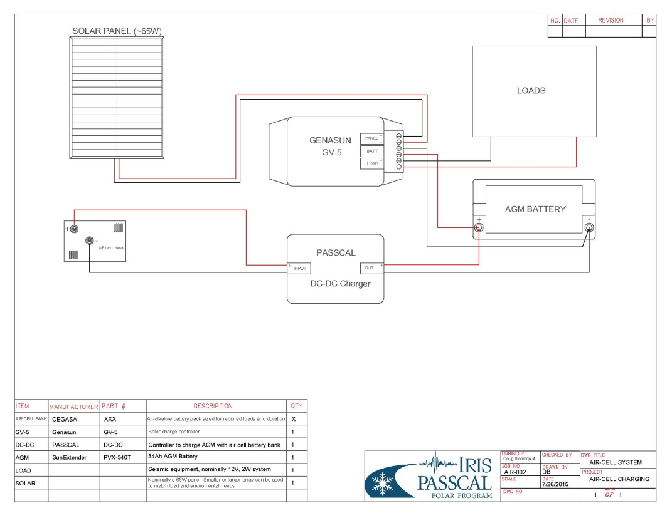
DC-DC convertor: In an attempt to bypass the cold weather limitations of Aircells, PASSCAL developed a DC-DC convertor to “trickle charge” a secondary battery capable of sourcing more current in the cold.
Air Alkaline Batteries
Wide input range (13-50V)
Can be programmed for max output of 50 to 600mA
~94% efficient when pulling from a 17V source to charge a 12.6V battery (AGM)
Notes:
In an attempt to mitigate this problem, a previous PASSCAL engineer designed a DC-DC convertor to essentially trickle charge a small lead acid or other low impedance battery using the aircells, allowing the low impedance battery to handle the surge currents while maximizing usable capacity from the aircells. You can see in the graph a 600Ah aircell bank run at -20C connected direct to the seismic system loads and the associated data gaps at the left, compared to the nearly 8 weeks of autonomous operation with no solar input and no data gaps when connected to a small AGM via the DC-DC convertor. We are currently testing units for production and expect to have these available to customers in the near future.
DC-DC converter to charge a low impedance battery with a high impedance source (air alkaline batteries). In this way, the loads can be left connected to a low impedance battery that is able to source the required pulse currents without a significant voltage drop. The air alkaline batteries can then be discharged at the average current required by the system. This solution will allow for the air alkaline bank to be much smaller and will help to eliminate the reboots and loss of data seen at colder temperatures
Testing of the DC-DC converter has allowed an 18V, 600Ah air alkaline battery pack to power a 2W seismic load for over 8 weeks at -20C
Additionally, the DC-DC converter can be part of a hybrid system that makes use of solar energy when available. An example power system that utilizes air cells and solar energy is shown in Appendix B. The converter only begins to charge the low impedance battery once its voltage has fallen to 12.4V. Hence when solar energy is available, the converter will sit idle and not pull energy from the air alkaline pack.
The converter has a wide input range of 13V to 50V. This allows for much different air alkaline or other battery systems to be designed and connected. It can be programmed to have a maximum output current from 50mA to 600mA (i.e. the maximum current it will pull from the high impedance batteries to charge the low impedance battery). It is around 94% efficient when pulling current from a 17V source to charge a 12.6V battery.

Slide 19
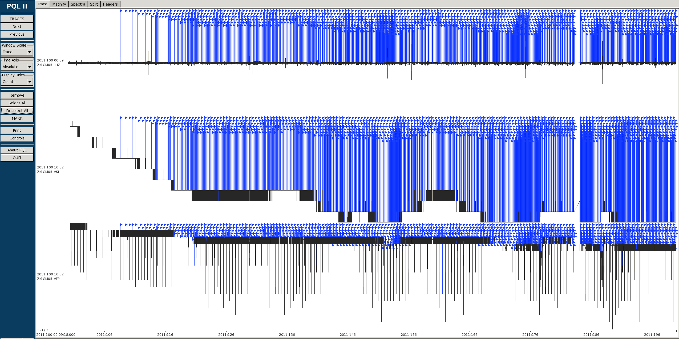
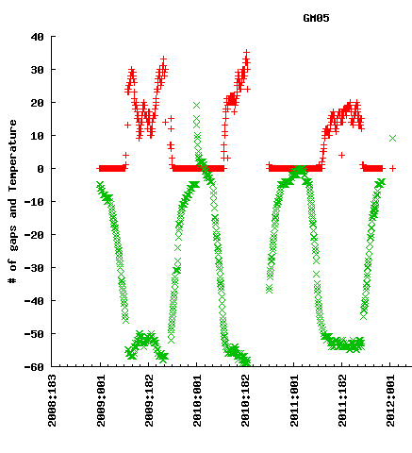
Wind Powered Heater
Year round stations operating on the East Antarctic Plateu experience data gaps and poor clock quality during the winter months due to a the VCO operating out of spec, resulting in weeks or even months of data that is discontinuous to the point of being unusable .
~6 months
Notes:
Next I am going to talk about a wind powered heater we have been developing with APRS World. I think James is giving a talk tomorrow so hopefully he can fill in any holes in what I am about to say. For a little background on the impetus for this project, our stations currently operating on the east Antarctic plateu experience data gaps during the coldest winter months when the Voltage Controlled Oscillator used for keeping time is no longer able to function.

Slide 20
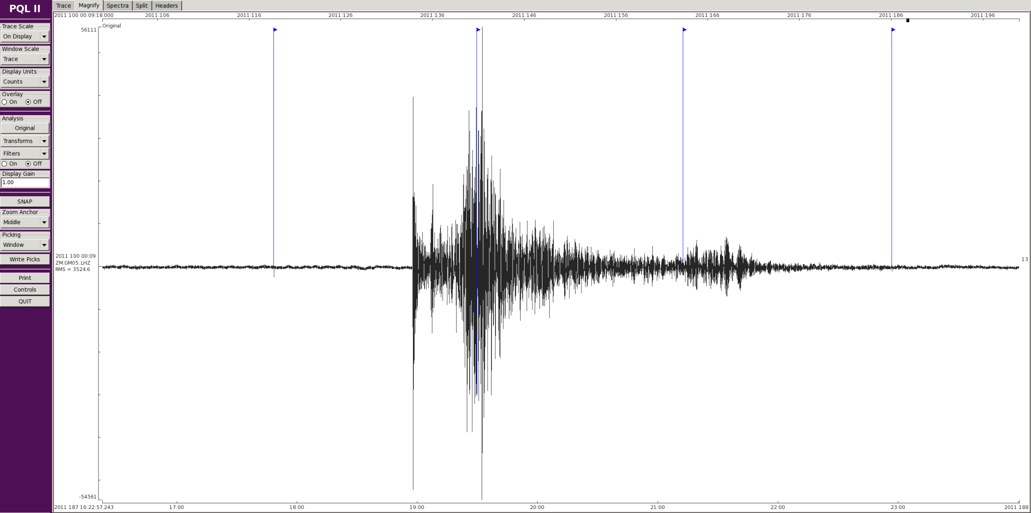
Wind Powered Heater
7.6 Earthquake Near NZ in 2011

Slide 21
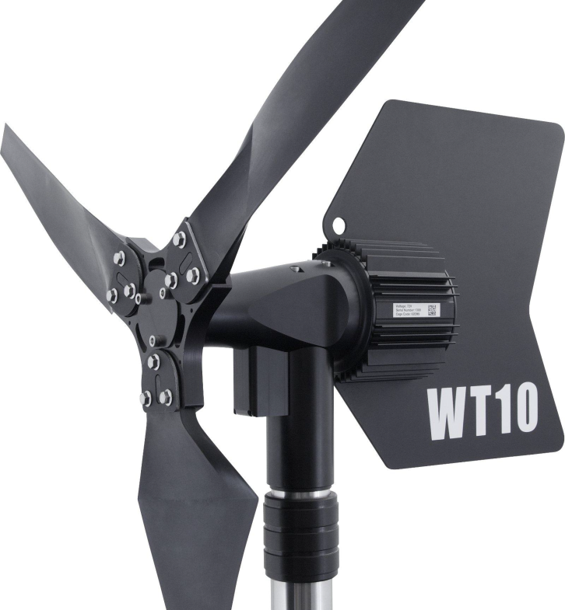
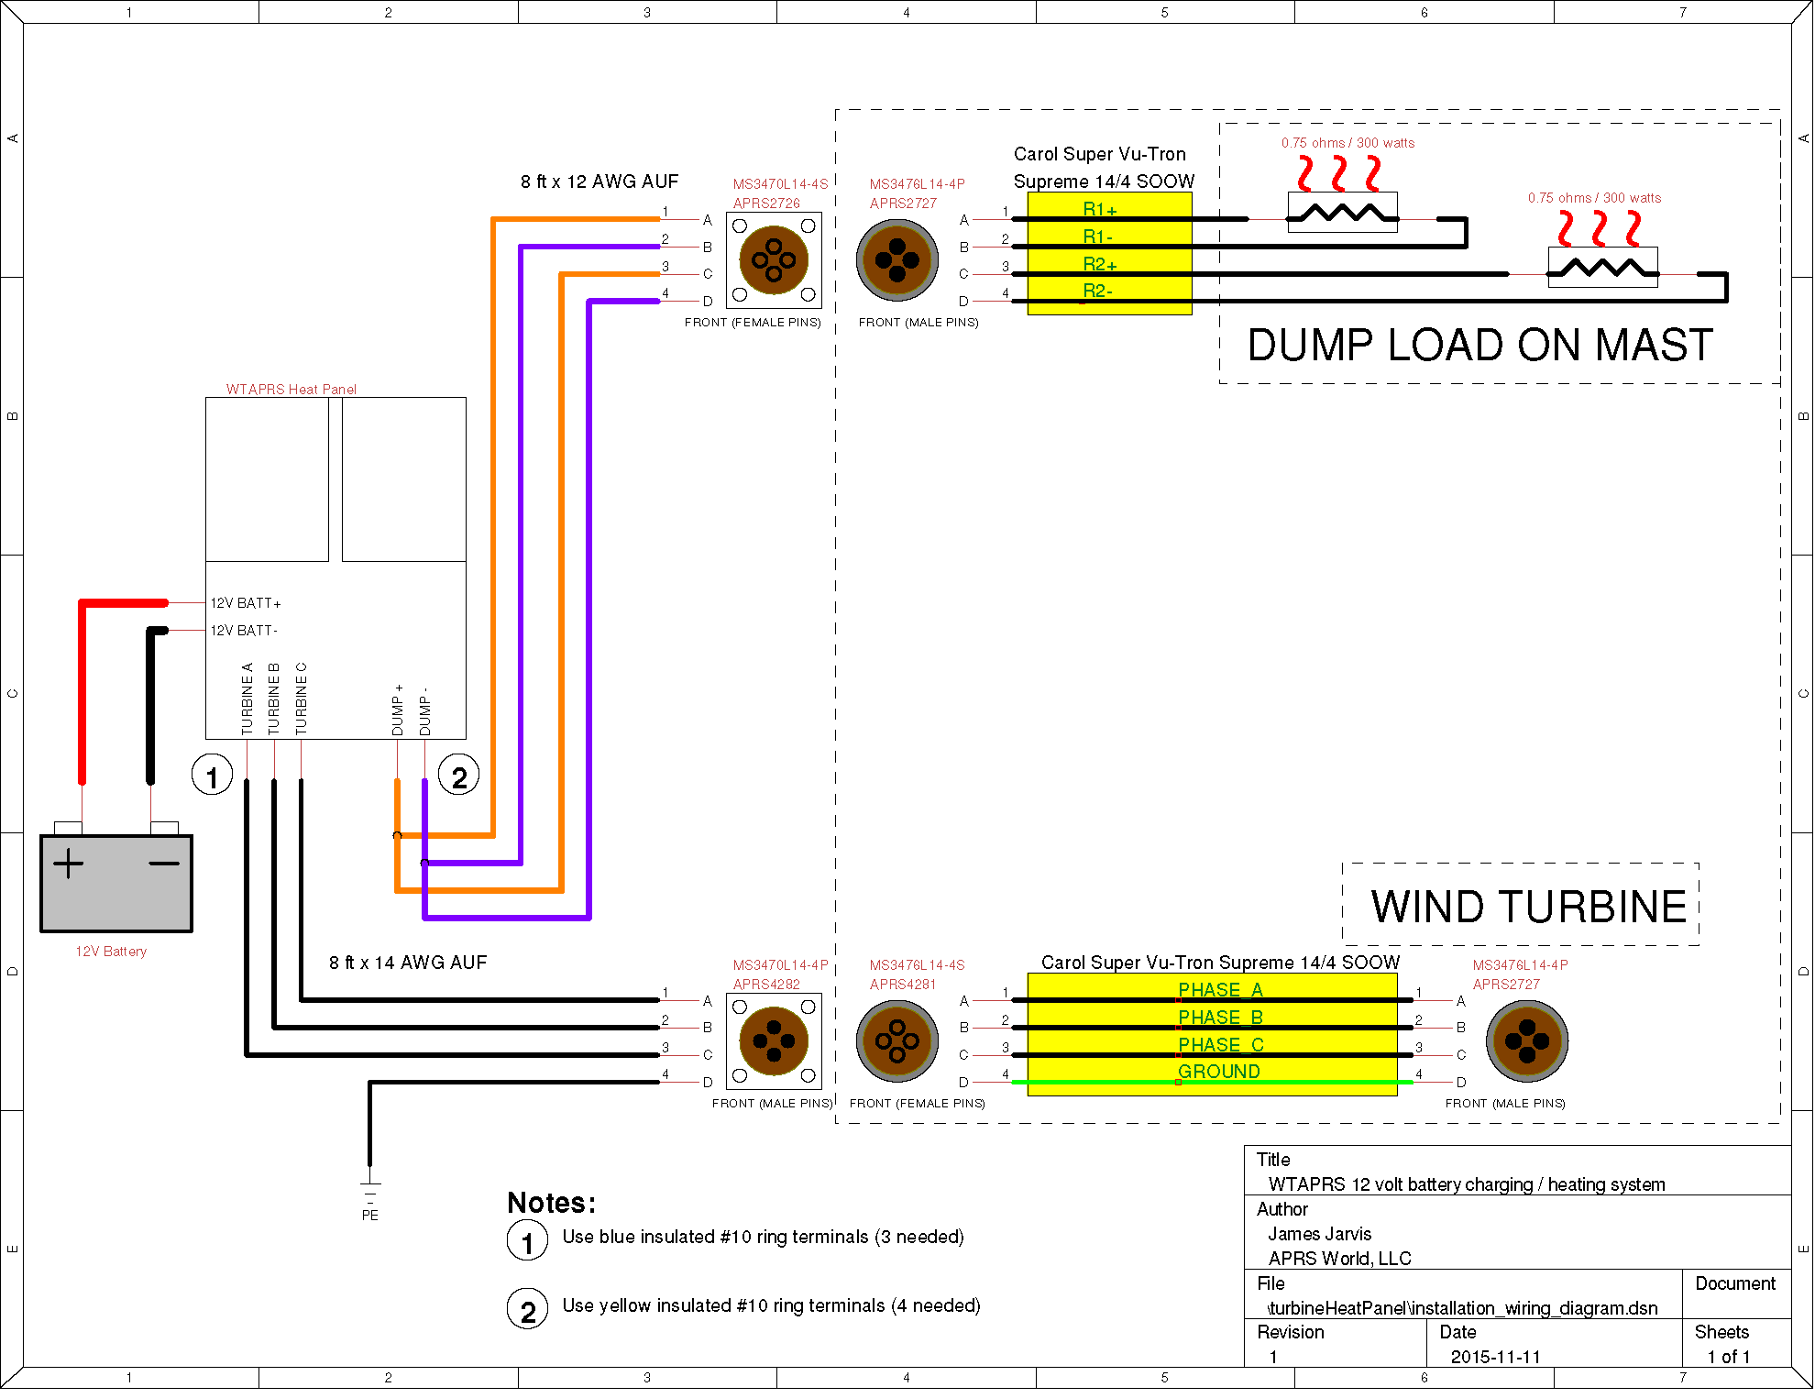
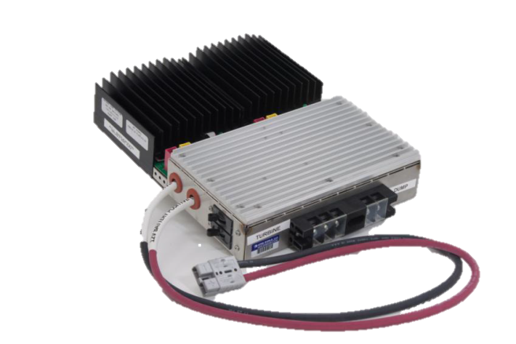
In an attempt to mitigate this problem, we have worked with APRS World to develop a heater/controller to attempt to keep the stations above the operating spec of the VCO. Test units were installed at P061, a previously existing seismic station in the East Antarctic, and at our test site near Castle Rock, just North of McMurdo Station.
Wind Powered Heater
Notes:
We have been working with APRS world to develop a wind powered heater for use at our coldest sites on the East Antarctic Plateu and, hopefully, beyond. Explain setup:
Ruggedized for harsh conditions
cold temp grease. James came to PIC and did startup speed tests in fridge
been done successfully at AGOs with large turbines. Trying to develop micro wind turbine (low logistics) that will work at low wind speeds experienced on plateau (part of motivation. Sites getting power from AGOs have no issues). If fails, large turbines may make sense…

Slide 22
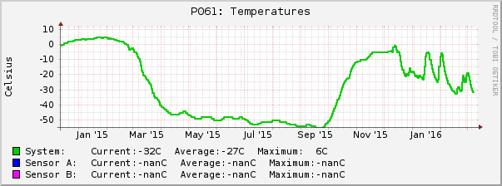
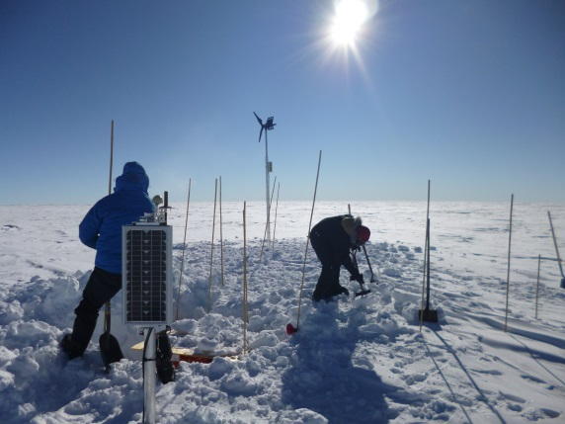
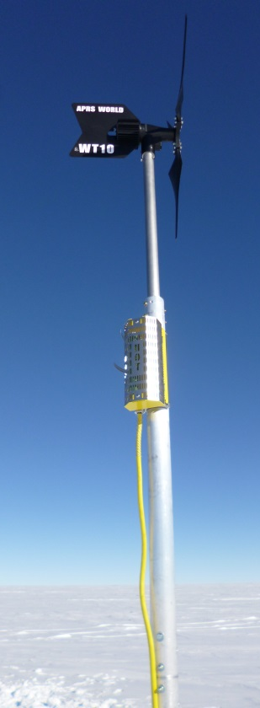
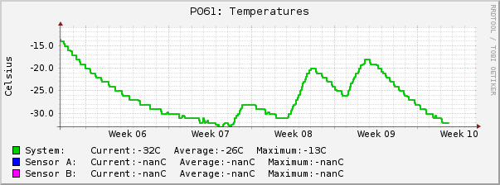
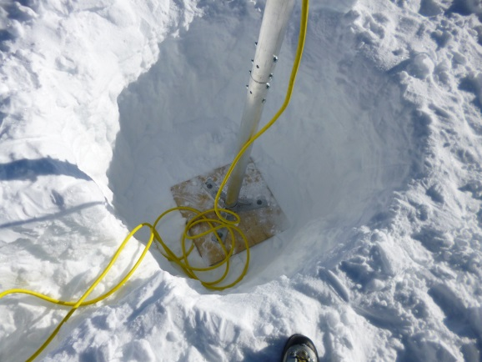
Wind Powered Heater
P061
Wind turbine system isolated from seismic system (charging separate battery which is not powering equipment) and solar charge system
Low wind speed, very cold (higher startup speeds as grease gets colder)
Intermittent heating, efficacy remains to be seen as temps approach VCO limit
Notes:
Similar install technique to “lampshade” (explain) but buried deeper
Mast 12 foot total (not including APRS mast) of 3” tubing,

Slide 23
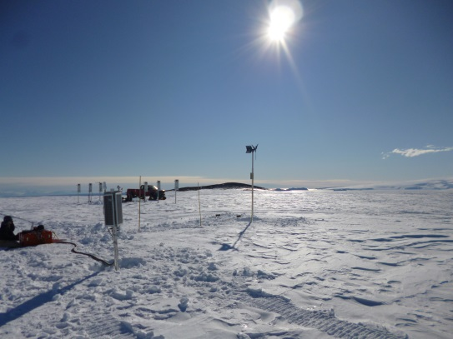
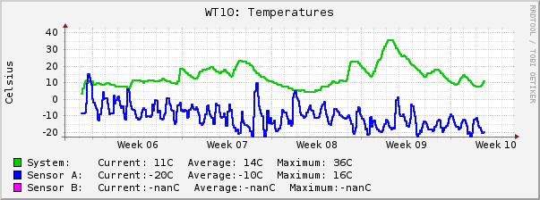
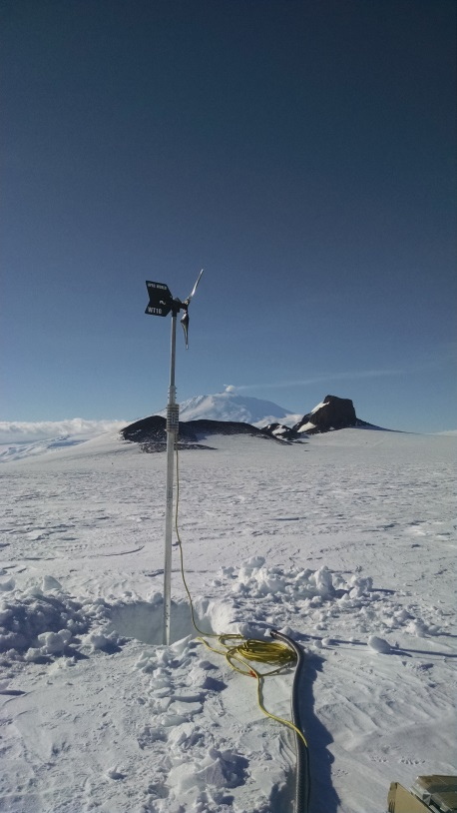
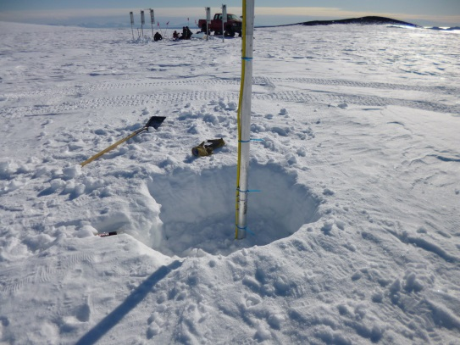
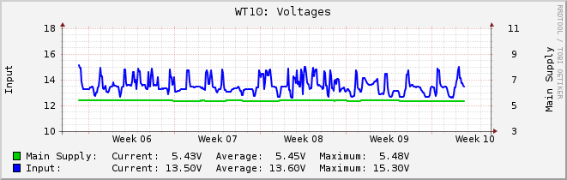
Wind Powered Heater
Castle Rock
Wind turbine system charging 2 34Ah AGMs, paralleled with solar and also powering equipment
Strong and consistent wind keeping batteries charged and box warm. Longevity/durability of turbine/install method will be the takeaway here
Notes:
Castle rock getting good charging and heat

Slide 24
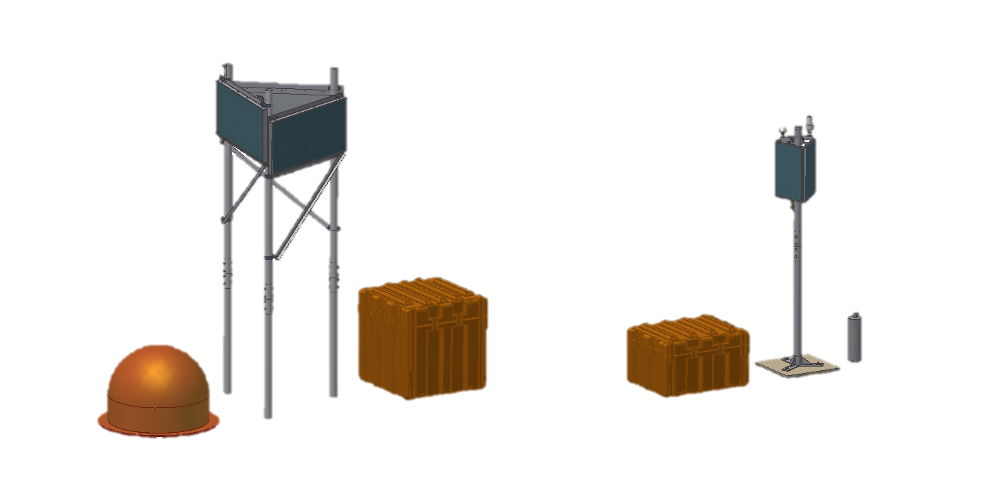
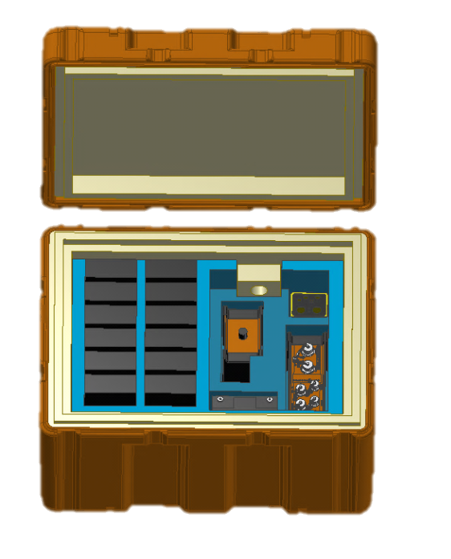
Next Generation Seismic Station
Development prompted by funding for 3 separate funded projects for deployment during the 2014/15 Antarctic season.
    Focus on rugged design and reliability at minimal logistical and financial cost
    Unprecedented 44 stations successfully deployed during 2014-15 season
Semi-permanent, Extreme Cold Station
8x 108Ah AGM Batteries
Heavily insulated enclosure
Broadband Surface Seismometer in insulated vault
Appx total weight 1000 lbs
5-10 year battery life
2 year, Moderate Cold Station
10-12x Lithium Primary batteries +1 34Ah AGM
Moderately insulated enclosure
Direct bury broadband posthole seismometer
Appx total weight 250 lbs
2 year battery life
Notes:
All iridium sbd telemetered
Deployed by TO as well as snow mo traverse from WSD
Approval from ANG in addition to KBA to transport loaded (Big achievement! Was able to ship traverse stations loaded from MCM to WSD
Wanted to be small and light, yet rugged. Equipment and batteries held by foam so could be transported loaded with Li batts without issue
Easily moved with 2 people
approval

Slide 25

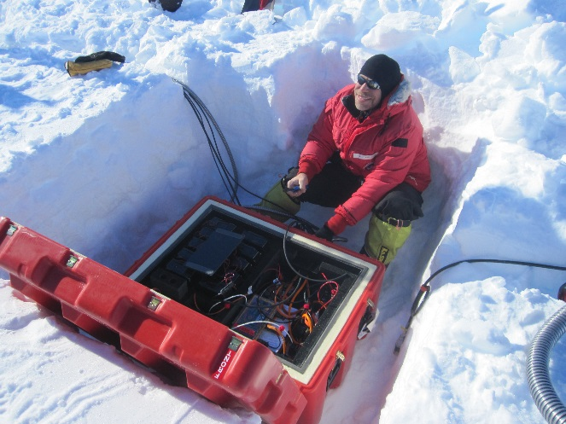
Next Generation Seismic Station
44 RIS Enclosure Systems installed in the 2014-2015 Antarctic Season
2015/16 Service results/data return:
  Great success overall!!
  ~2hr service time at each station
  >95% data return
    ~4 sites had issues during AGM-Li switching transition
    1 baler failure resulting in ~1 mo. Data loss
Notes:
Update for this field season. Results/data collection data

Slide 26

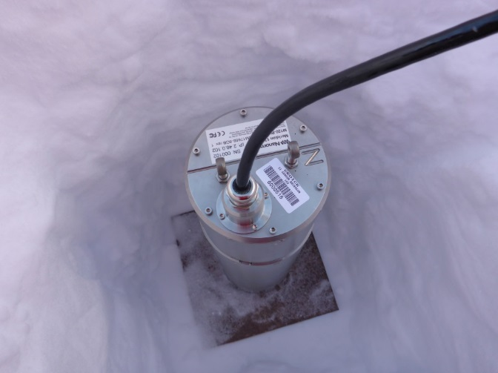
GeoIce MRI
MRI – Partnership between Central Washington University and IRIS to develop new instrumentation specifically for polar regions. Will include a mixed phase array consisting of broadband and intermediate band seismometers complete with power systems and enclosures.
  Low power, both types integrate a digitizer and post hole seismometer for installation in snow/ice
  Environmentally sealed, built for limited and difficult logistics
  Improved tilt tolerance
  Target is 125 element array
  Two Nanometrics “All-in-one” units, a Meridian Compact, intermediate band instrument and a Meridian 120 broadband unit currently operating at South Pole SPRESSO site
Notes:
Add pic of 120 ph

Slide 27
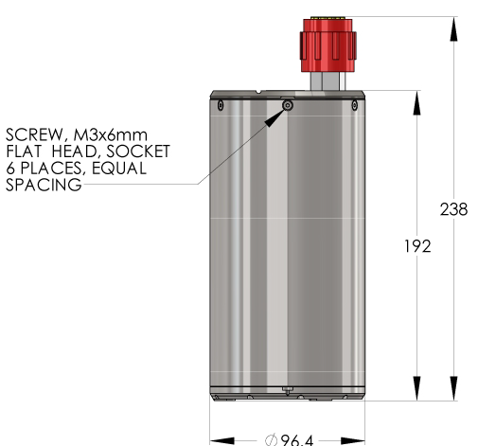
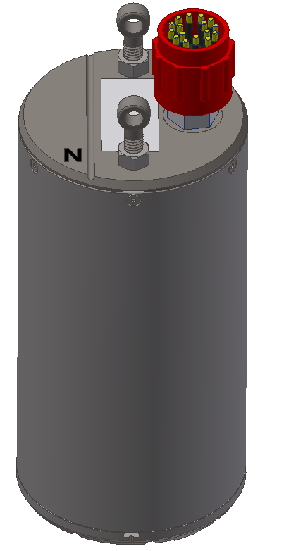
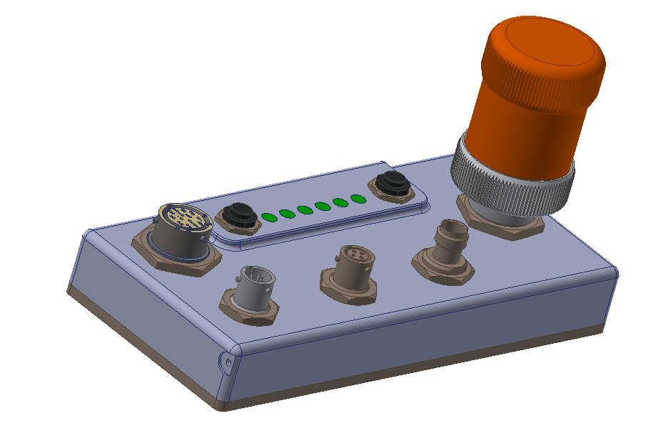
GeoIce MRI
New revision fixes many early mechanical issues:
  Updated connector for field usability
  Ruggedized Surface Interface Unit (SIU)
  Better isolation between data logger and sensor

Slide 28
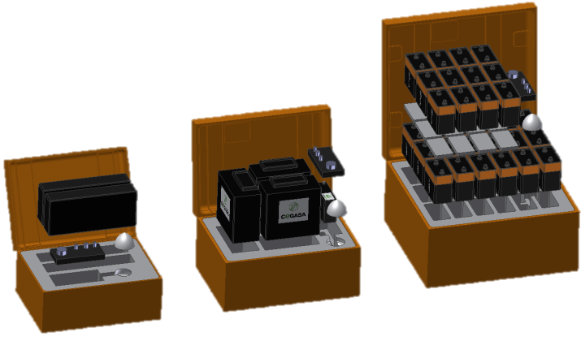
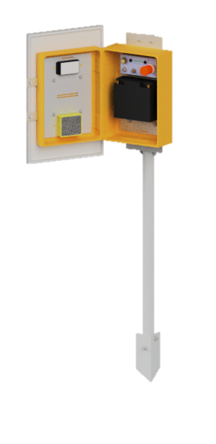
GeoIce MRI
Taku Glacier Test Deployment: Several systems were deployed on and around the Taku glacier near Juneau AK during the Summer and Fall of 2015 in both “Summer Only” and year-round configurations .
  Focus on modularity; ability to expand station by adding battery power without removing existing equipment
  Several different battery chemistries and configurations tested used
Aircell System
Alkaline System
Lithium Primary System
Station | Chemistry | # Batteries | SIU | Sensor | Panel | Box Model
Winter 1 | Alkaline | 30x MN918 | External | Compact | 20W | AL2221-1802
Winter 2 | Aircell | 3x 6V 4AS10 | External | Compact | 20W | AL1616-0505
Winter 3 | LTC | 2x Custom Pack | External | Compact | 20W | AL1616-0404
Winter 4 | AGM | 4x 108Ah | Internal | Compact | 45W | AL3018-0905
Winter 5 | LiFePO4 | 3x 100Ah | Internal | Compact | 45W | AL2216-1203
Winter 6 | AGM | 8x 108Ah | Internal | 120 | 45W | AL3018-0905
Winter 7 | LiFePO4 | 6x 100Ah | Internal | 120 | 2x 45W | AL2216-1203
Notes:
Consider putting design drawings/photos on this page, install photos etc on next slide

Slide 29






GeoIce MRI

Slide 30





GeoIce MRI
Solar Panel Mast Pull Down Test
Configuration 1 Configuration 2
Results
Configuration 1 began to plastically deform at 550 lbs, without pulling out. While testing Configuration 2 the rope attached to the truck broke at 688 lbs, with no signs of plastic deformation or pullout (other than a very slight lean) in the mast. Further testing would be required to determine final failure load for Configuration 2.
Notes:
Want to do further testing in snow/ice environment. Ran out of time in Antarctica this year.

Slide 31

GeoIce MRI
Further Testing:
  SPRESSO and Castle Rock: 1 of each type of Meridian was installed at SPRESSO (South Pole test site) and Castle Rock (McMurdo test site). Both stations are being “real-time” telemetered.
  In house lab testing/characterization ongoing

Slide 32

ANY QUESTIONS??

