Slide 1
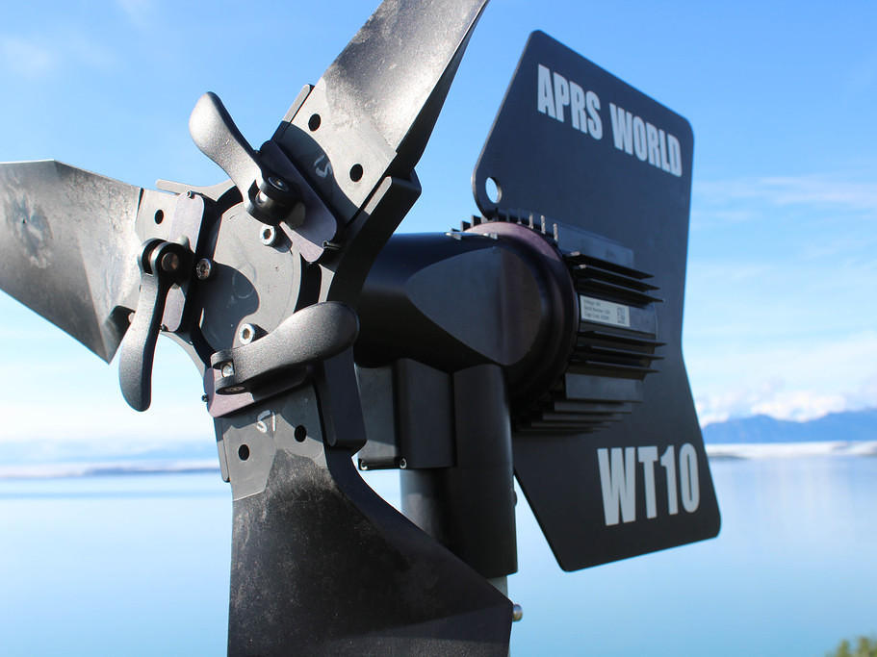
APRS World WT10 / WT14 Wind Turbine Update for 2016 Polar Technology Conference
James Jarvis
jj@aprsworld.com

Slide 2
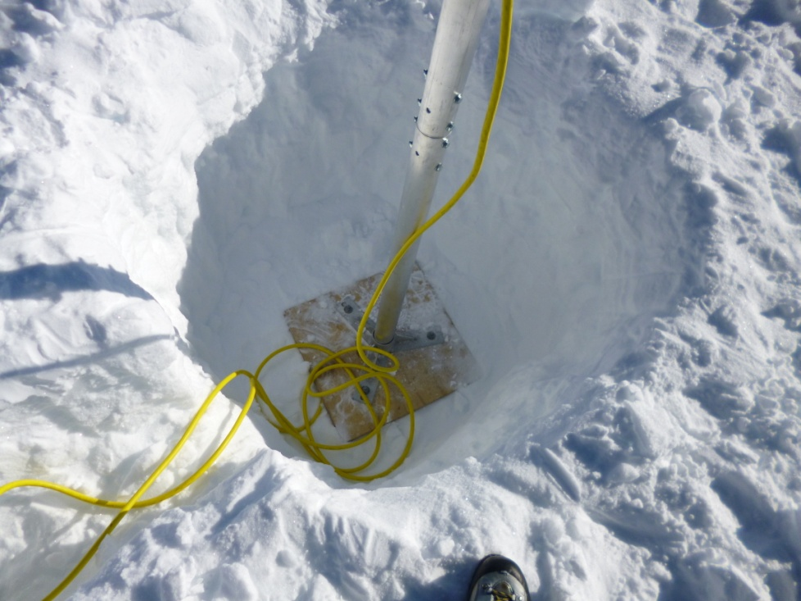
South Pole, Antarctica vicinity for IRIS/PASSCAL
WT10 for heating enclosure and charging 12 volt battery
Experimental snow anchored mast
Photos by Jason Hebert (IRIS / PASSCAL)

Slide 3
Heating Panel
Charges battery
Heats enclosure until set point is obtained
Dumps excess power to dump load on turbine mast
Incorporates all turbine control panel electronics
stop switch, rectifier, power distribution, circuit breakers, dump controllers

Slide 4
Cold Weather WTAPRS Turbine
Replaced grease in all bearings with Dow Molykote 33 low temperature grease
Removed seals and used ultrasonic cleaner and Simple Green to remove original grease

Slide 5
Results at South Pole
Primary objective is to heat enclosure to keep oscillator warm enough
With sun down, any heating is from the wind turbine
Limited wind at these sites. WT14 may be better.
Live data at https://xeos.passcal.nmt.edu/cgi-bin/details.cgi?stationid=1

Slide 6
McMurdo, Antarctica vicinity for IRIS/PASSCAL
Photo by Jason Hebert (IRIS / PASSCAL)
Live data at https://xeos.passcal.nmt.edu/cgi-bin/details.cgi?stationid=341

Slide 7
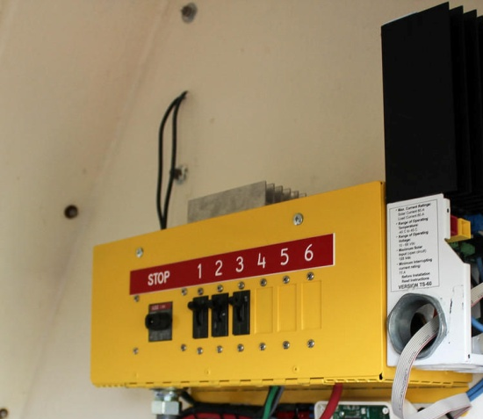
Bering Glacier, AK for Alaska Earthquake Center
WT10 installed on existing communications tower
Supplementing PV that wasn’t meeting energy needs in winter months
With turbine, system availability this winter was 100%!

Slide 8
Ethernet Weather Camera
PCWX camera monitors turbine performance and site status
wind speed, turbine RPM / power output, battery voltage, temperatures
Developed Ethernet (non-Wi-Fi) version for this project
100% uptime since installed July 2015

Slide 9
Juneau, AK for Alaska Marine Exchange
WT10 supplying power for ocean current sensor, ultrasonic weather station, and dock navigational light (10 to 20 watts continuous load)
No solar, wind only
Nearly 100% uptime since installed fall 2015

Slide 10
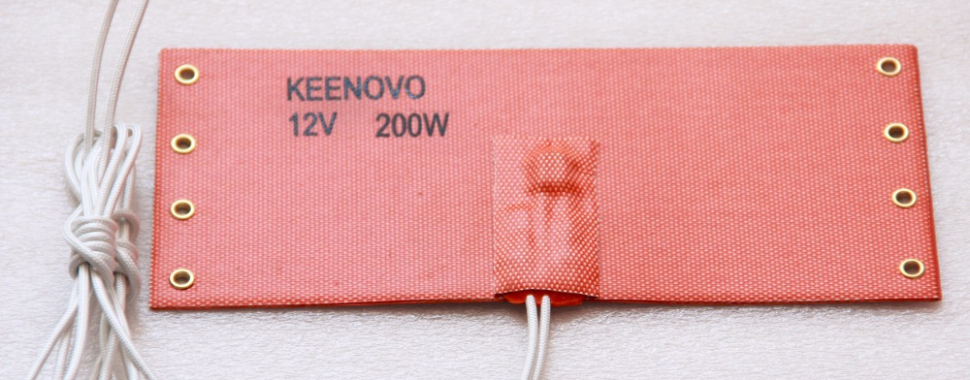
Heating Pad Dump Load
Using adhesive backed silicone heat pad for dump load
Mounts to extruded aluminum heat sink
No exposed connections to corrode in marine environment

Slide 11
Modbus Bridge for Weather Camera
Added capability to PCWX for RS-485 attached Modbus devices
Now camera can directly monitor and control charge controllers, sensors, controllers, and many other industry standard widgets

Slide 12
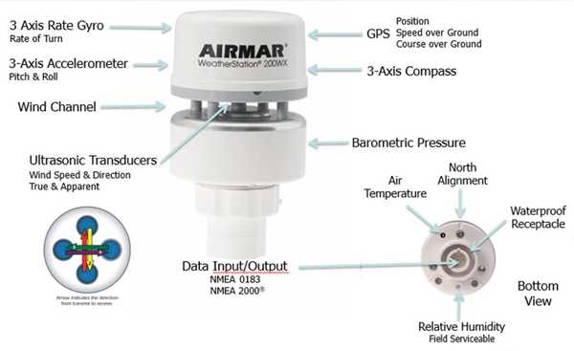
NMEA0183 for Weather Camera
Receive capability for NMEA0183 sensors
GPS, weather stations, clocks, marine sensors, etc
Weather camera can now consist of two parts (camera and weather multi sensor) and provide full met station
Diagram from fondriest.com

Slide 13
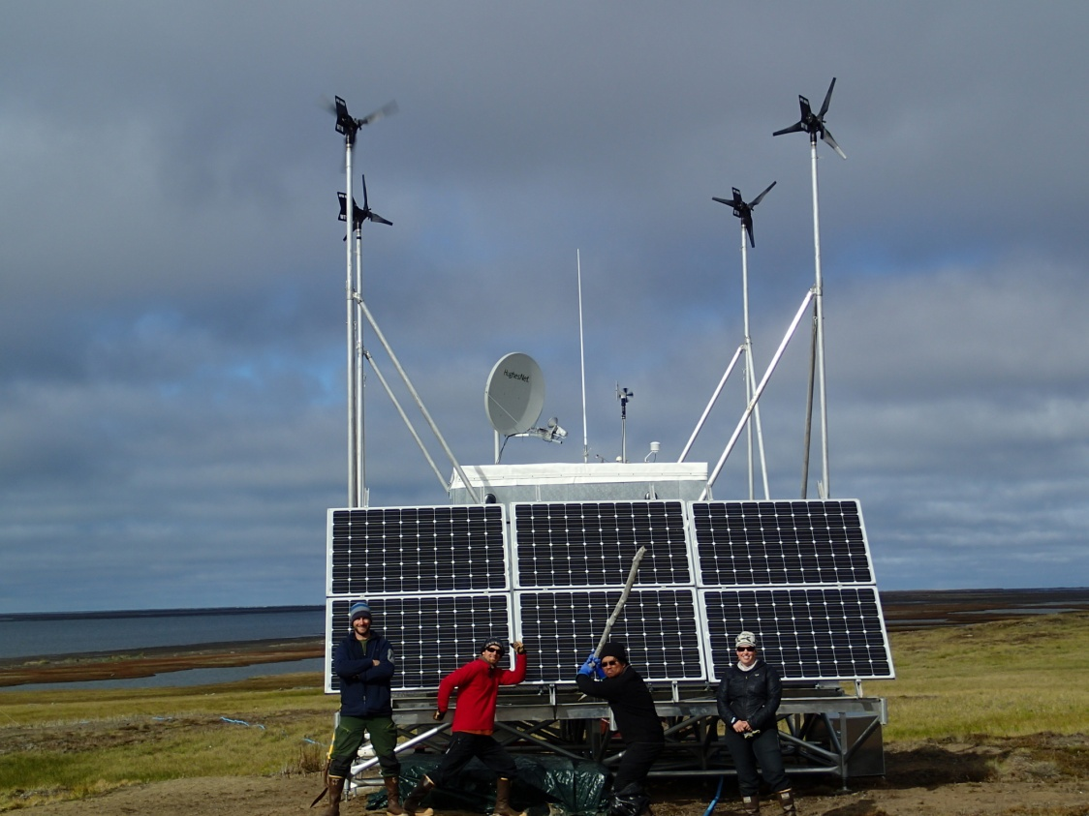
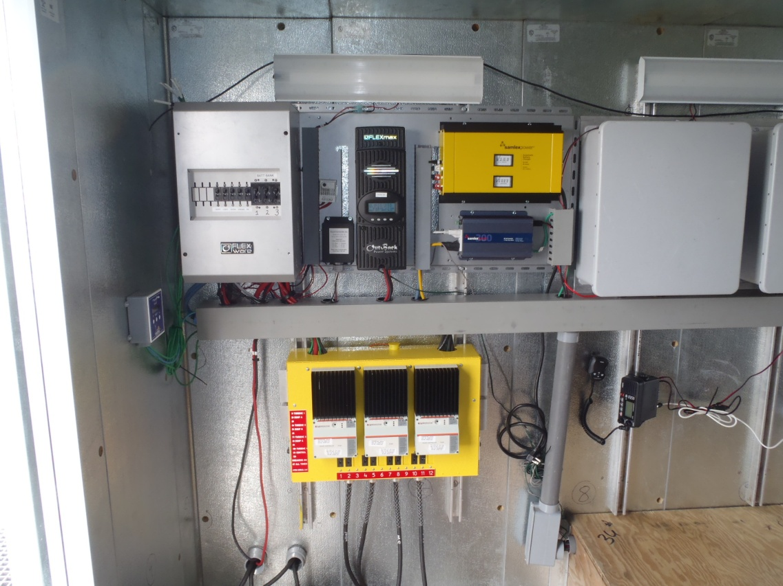
Arctic Ocean coast, Alaska for University of Alaska Fairbanks
Four WT10 wind turbine per site
Provide season power for coastal radar
Deployed in multiple locations along coast
Photos by Hank Statscewich / University of Alaska Fairbanks

Slide 14
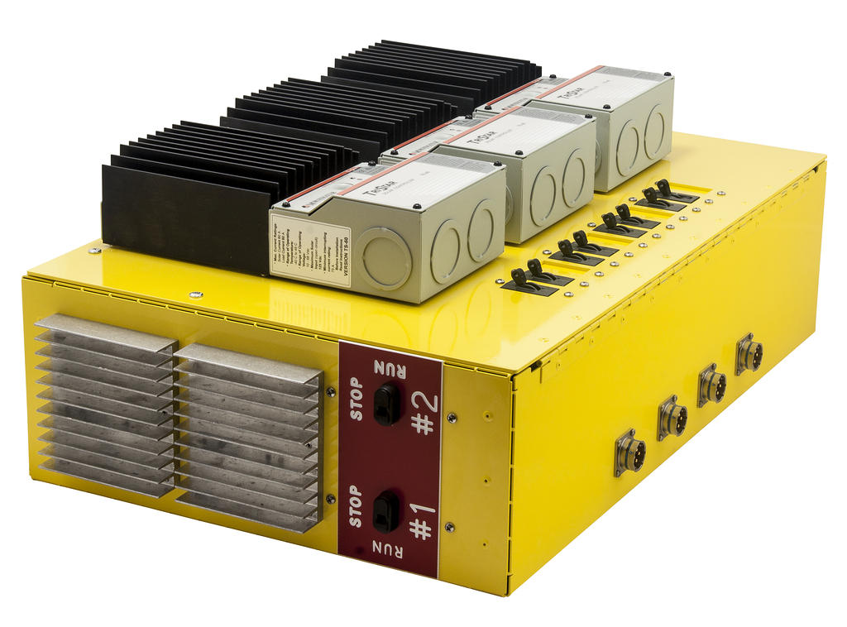
Quad Turbine Control Panel
Supports four turbines and internal and external temperature controlled dump loads

Slide 15
NOAA Climate Research Network various locations in Alaska
Photo provided by Mark Hall / NOAA
Adding wind turbines to existing sites to increase availability
Started with WT10 turbines and now going to WT14’s
Replacing fuel cells where there is wind resource

Slide 16
12 volt turbine winding

Slide 17
Spanish Fork, UT for APRS World testing
Ongoing power performance and longevity testing
Developing modified WT14 (WT13?) to reduce sound level

Slide 18
www.aprsworld.com
+1-507-454-2727

