Slide 1
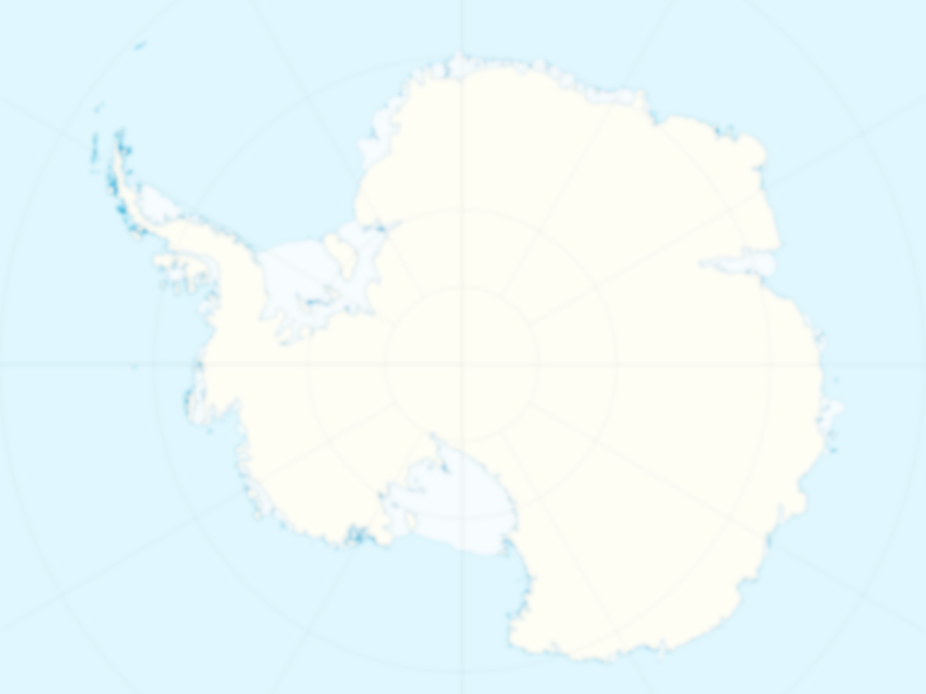
Dateline: Antarctica
Science Communication on The Ice

Slide 2
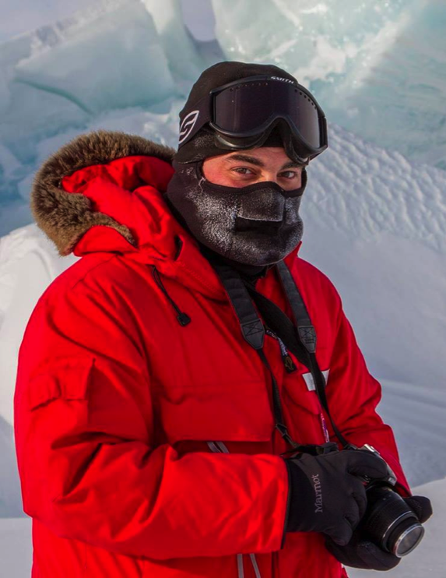
Who I Am
Michael Lucibella
Editor, The Antarctic Sun
One Ice Season (So Far)
BA and MA in Journalism & Minor in Applied Physics
6+ Years as science writer

Slide 3
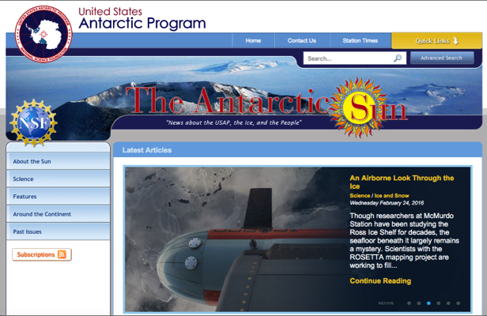
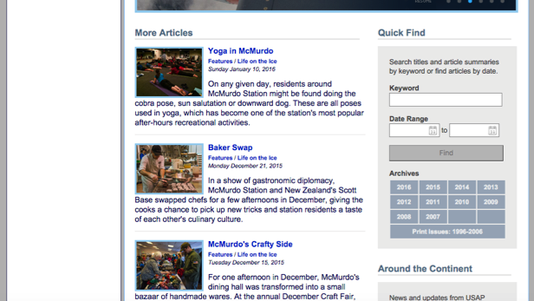
What Is
Website aimed at the general public.
Tagline is “News about the USAP, the Ice and the People.”
Stories about the science and the support that goes into it.
www.AntarcticSun.USAP.gov

Slide 4
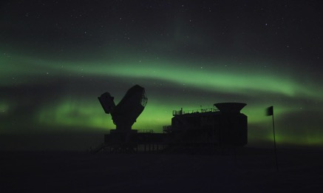
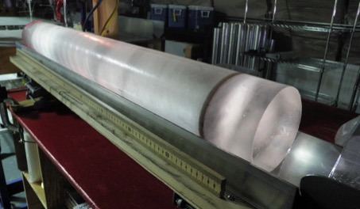
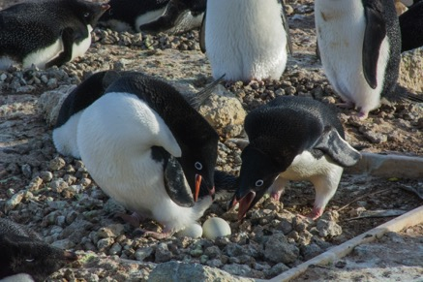
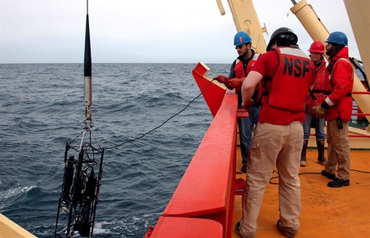
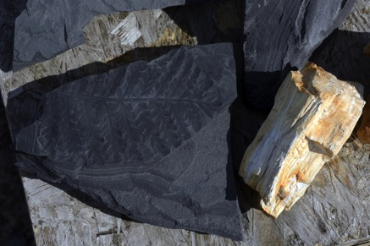
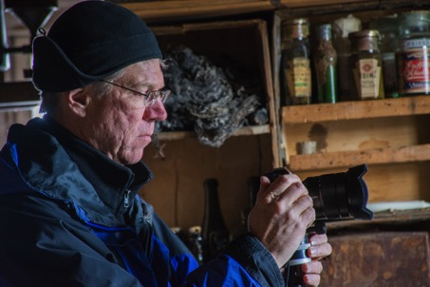
What Kinds of Science?
Astrophysics & Geospace
Glaciology
Biology
Ocean & Atmospheric
Earth Science
Artists and Writers

Slide 5
Gathering Stories
Stop #1: The annual Science Planning Summaries.
Usually printed and posted to www.USAP.gov around November
www.USAP.gov/scienceSupport/

Slide 6
Other Sources
Journals & Publications
Universities & Institutes
Mass Media
Government Agencies
Social Media

Slide 7
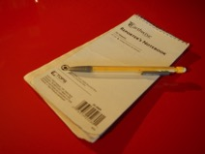
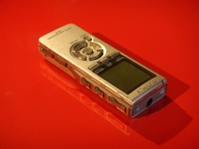
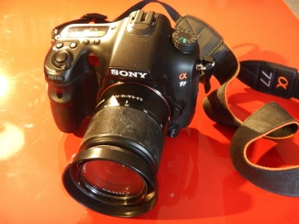
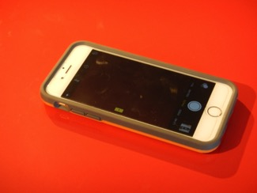
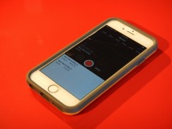
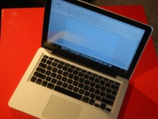
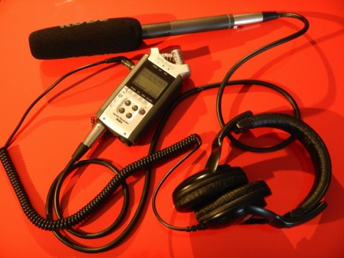
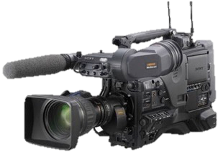
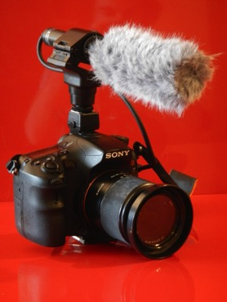
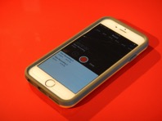
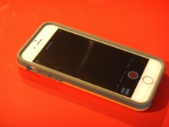
Tools of the Trade
- Depends on the Medium -
Print / Web
Photo
Radio / Podcast
TV/Video

Slide 8
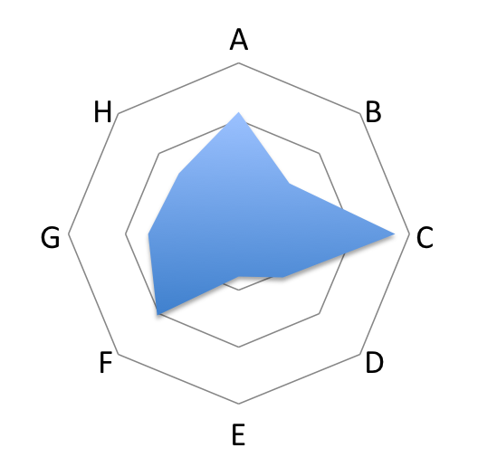
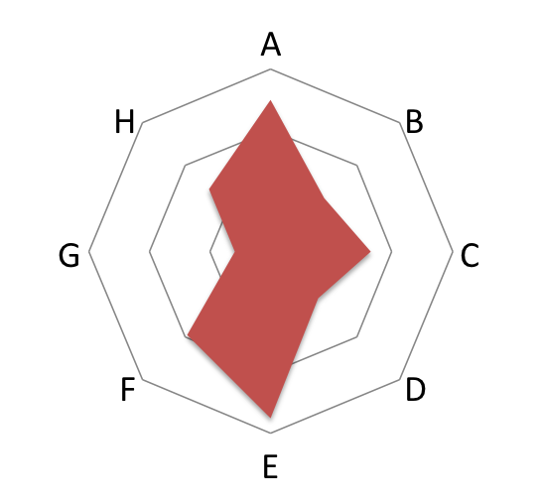
Science Journalism - More an art than a science -
Elements that Make a Good Story
New
Unusual
Unexpected
Not Widely Known
Interesting Individuals
Importance of Research
Compelling Images/Multimedia
Personal Interest
Story A
Story B

Slide 9
How to Talk to a Journalist
Dos
Don’ts
Look up who it is and what their publication is like
Ask what they want to talk about & what their focus is
Go in knowing what points you absolutely want to hit
Be prepared to answer seemingly basic or stupid questions
Be enthusiastic
Use a lot of technical jargon
Aim for a 9th grade audience
Pretend you’re explaining to your grandmother
Talk down
Ask to see/edit a story for the journalist
Say things you don’t want to see in print
Be combative

Slide 10
If You Have 5 Minutes with a Reporter
Just the Facts
Who/What/Where/When/How
Interesting anecdote “Color”
Analysis “What it Means”
The “So What”
Work
Field
The World
You

Slide 11
Thank You
Michael Lucibella
Michael.Lucibella.Contractor@USAP.gov
@MikeLucibella
www.AntarcticSun.USAP.gov
www.PhotoLibrary.USAP.gov
www.USAP.gov

